Slide 1


Utilizing the New Grant Application Software

Slide 2
Navigating to the Application

Slide 3
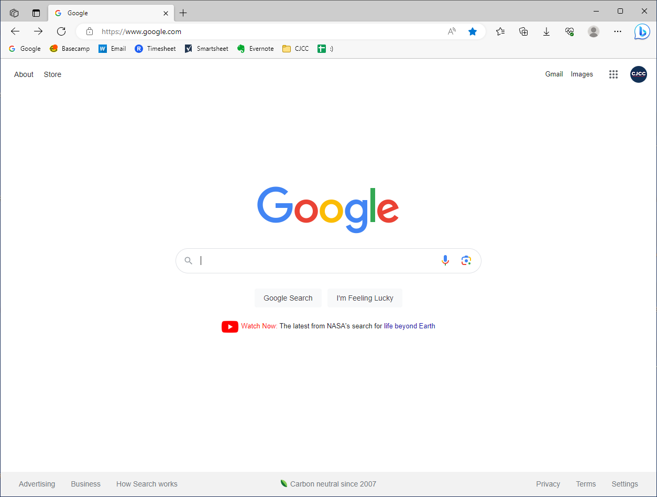
Navigating to the Application
Notes:
If we start from google,

Slide 4
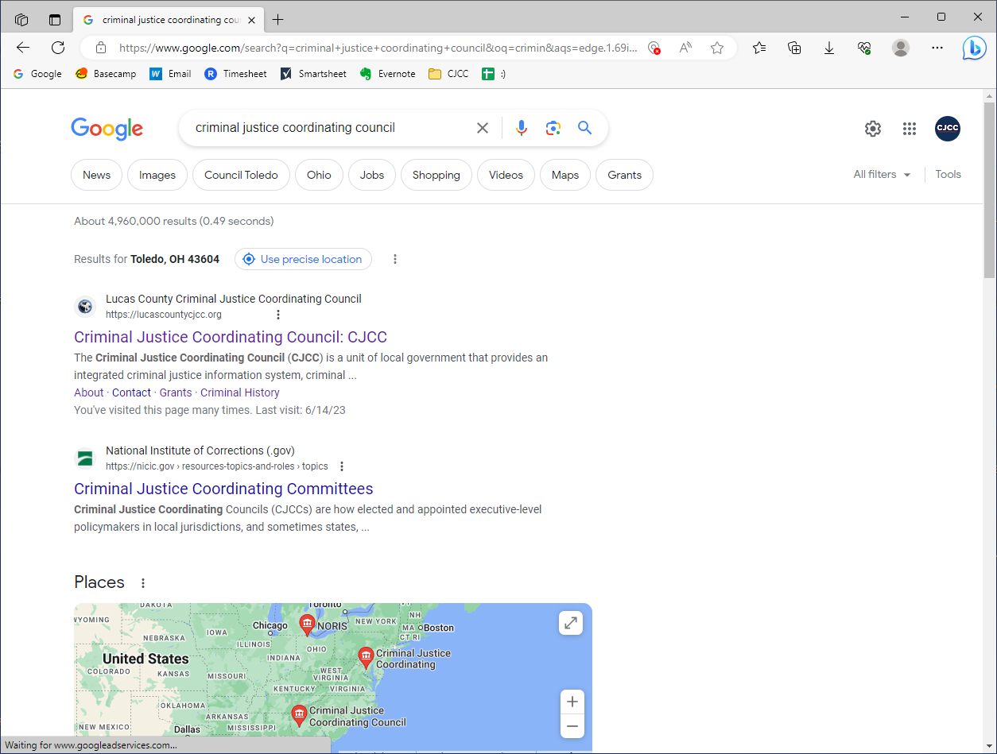

lucascountycjcc.org
Navigating to the Application
Notes:
Google criminal justice coordinating council and head over to our website. You can also use the link lucascountycjcc.org

Slide 5
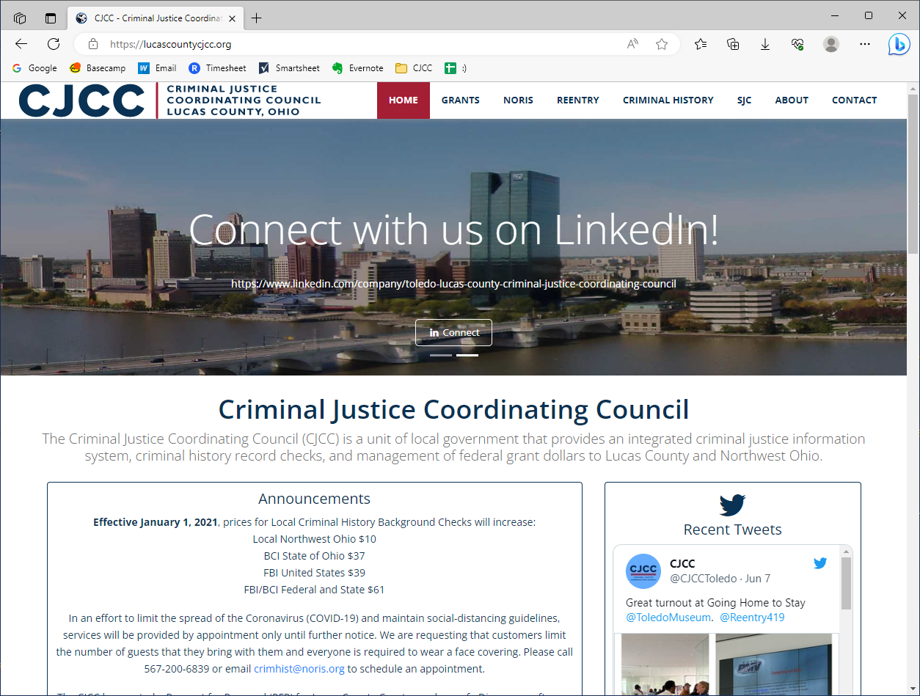
lucascountycjcc.org
Navigating to the Application
Notes:
Once on the site, click on “grants”

Slide 6
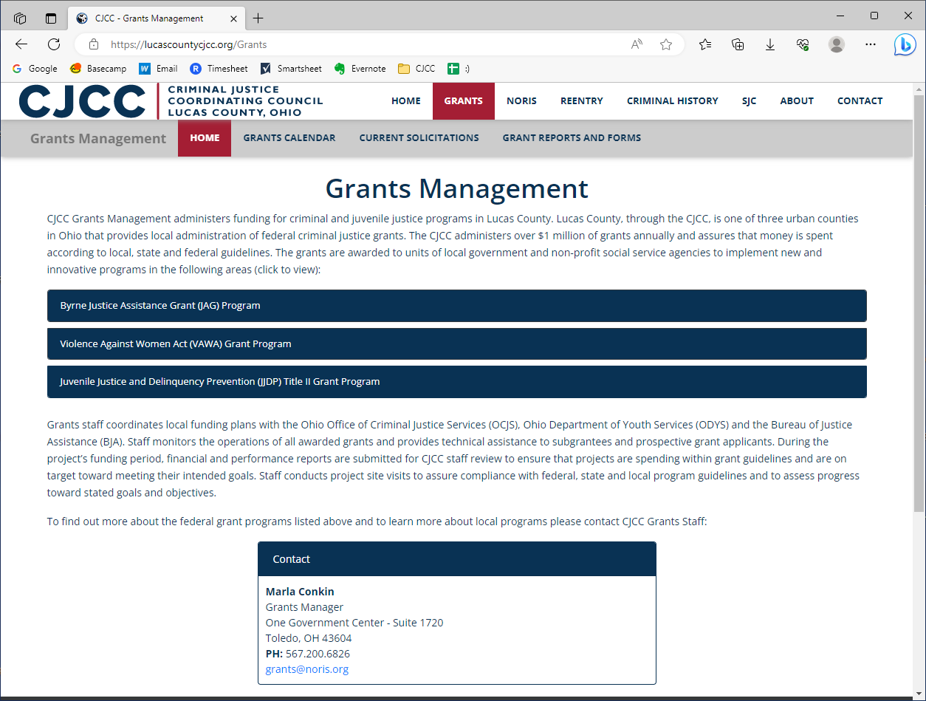
Navigating to the Application
Notes:
Then click on “current solicitations”

Slide 7
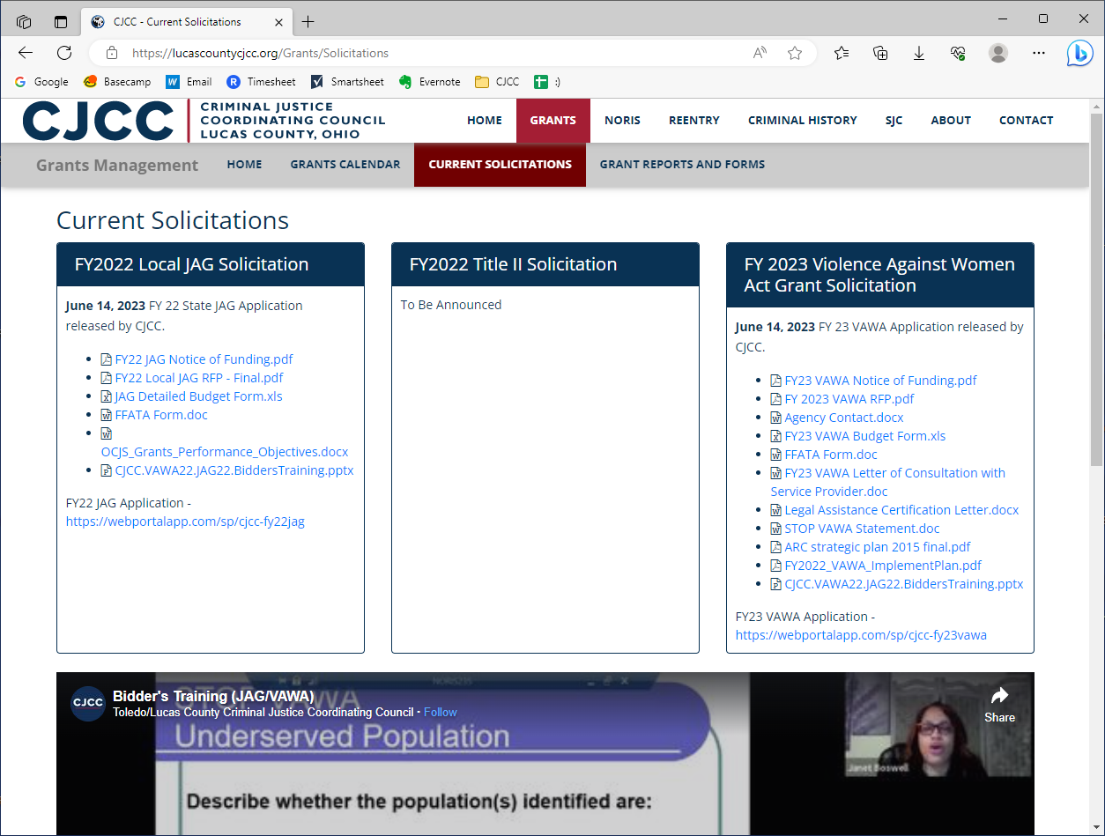
Navigating to the Application
Notes:
From there you’ll see the programs we currently have available. Right now, you can see JAG and VAWA, and we will be announcing Title II soon. To get to the JAG application, click on this link under “FY 22 JAG Application”

Slide 8
Navigating to the Application
Notes:
And then to get to the VAWA application, click on this link under “FY 23 VAWA Application”. We’ll have the link displayed for the Title II application once we release the Title II RFP.

Slide 9
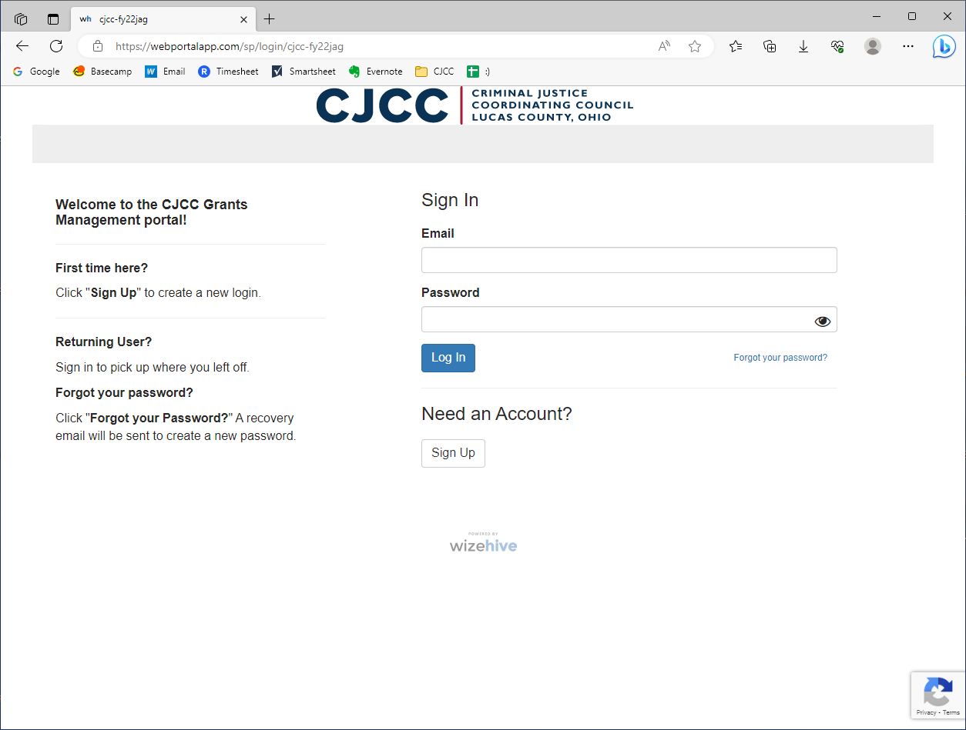
Navigating to the Application
Notes:
And then that will take you here, to the CJCC grants management portal. Note that there are separate portals for every program, so if you are applying for more than one program, you’ll want to save each specific portal link

Slide 10

Portal Links
FY22 JAG: https://webportalapp.com/sp/cjcc-fy22jag
FY23 VAWA: https://webportalapp.com/sp/cjcc-fy23vawa
Tip: Bookmark these portals!
Navigating to the Application
Notes:
You can see we have named the portals with the FY and the program’s acronym. These are the links you want to save or bookmark.

Slide 11
The Application Portal

Slide 12
The Application Portal
Notes:
Click on “Need an Account”

Slide 13
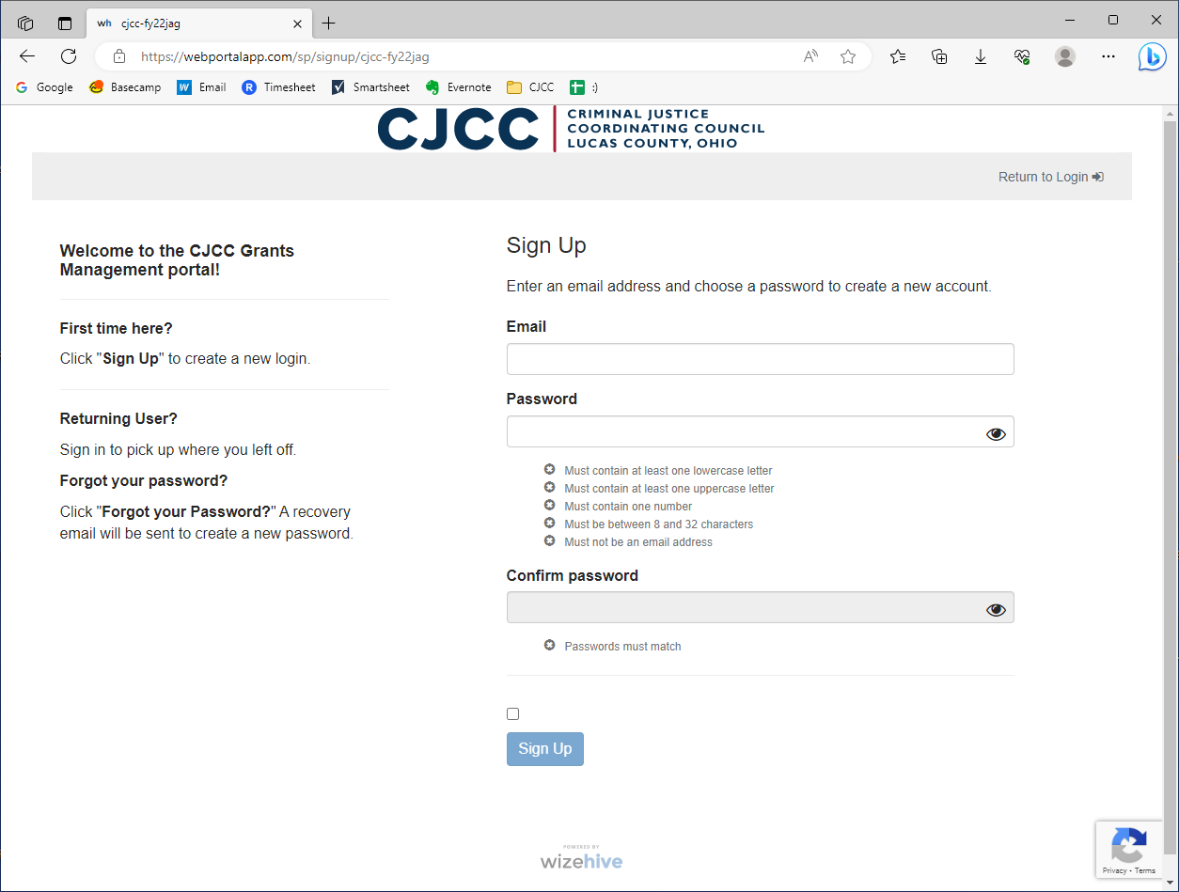
The Application Portal
Notes:
Enter your email and password.

Slide 14
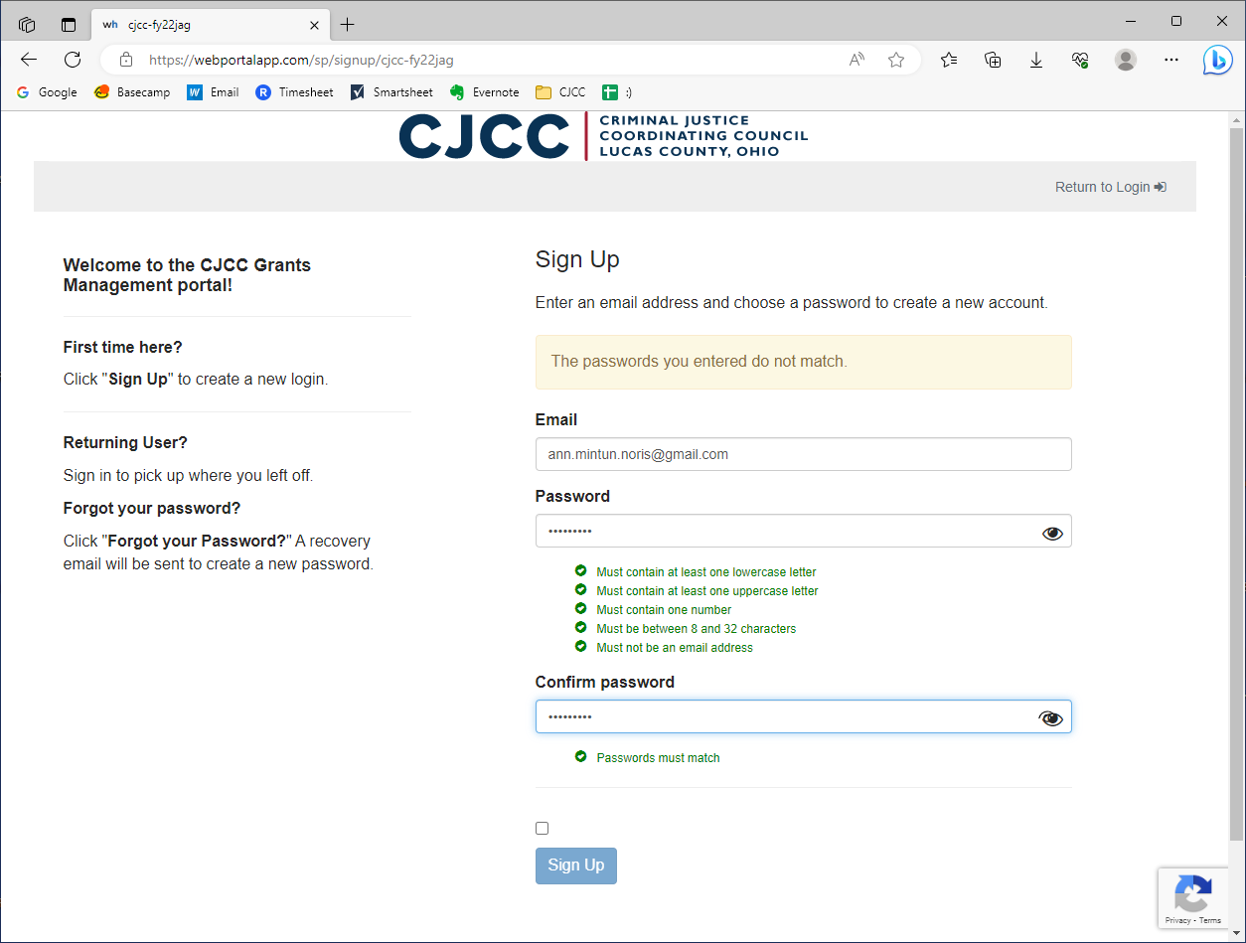
The Application Portal

Slide 15
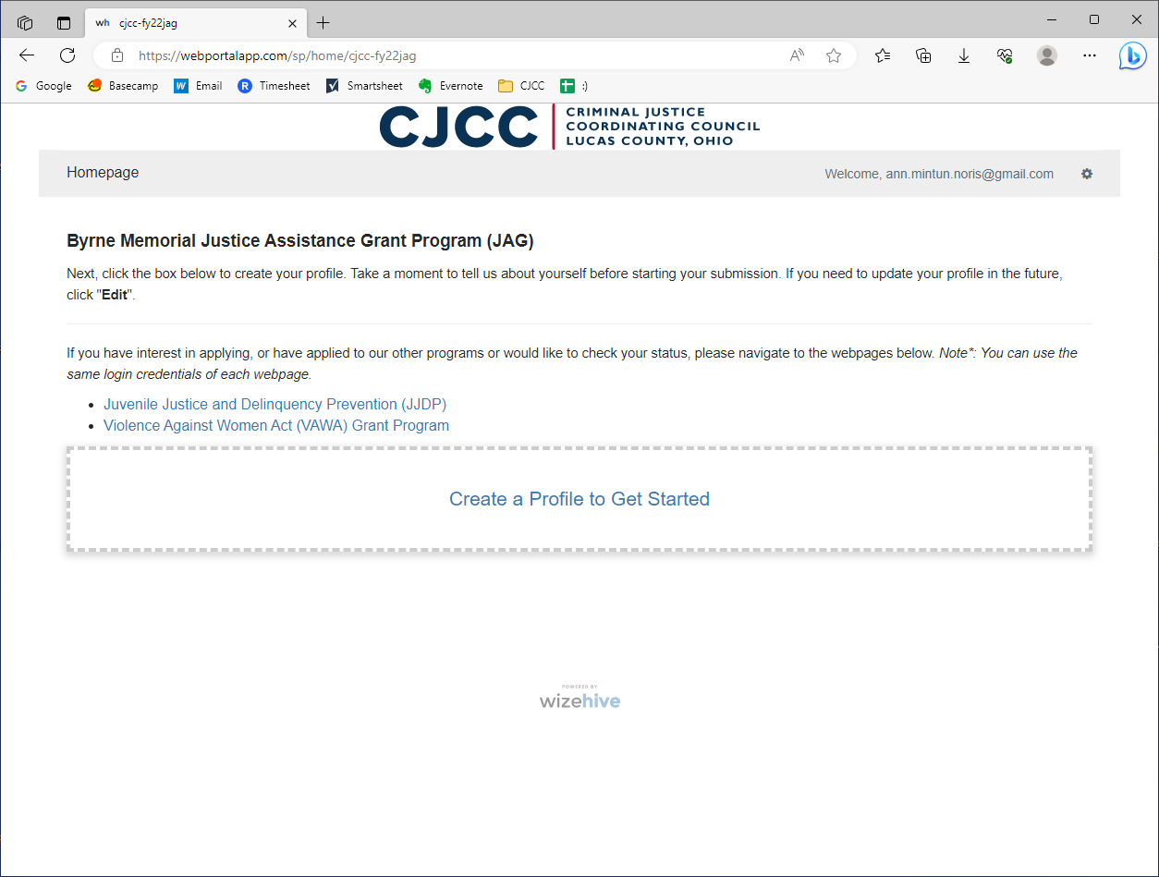
The Application Portal
Notes:
Then click on “create a profile to get started”

Slide 16
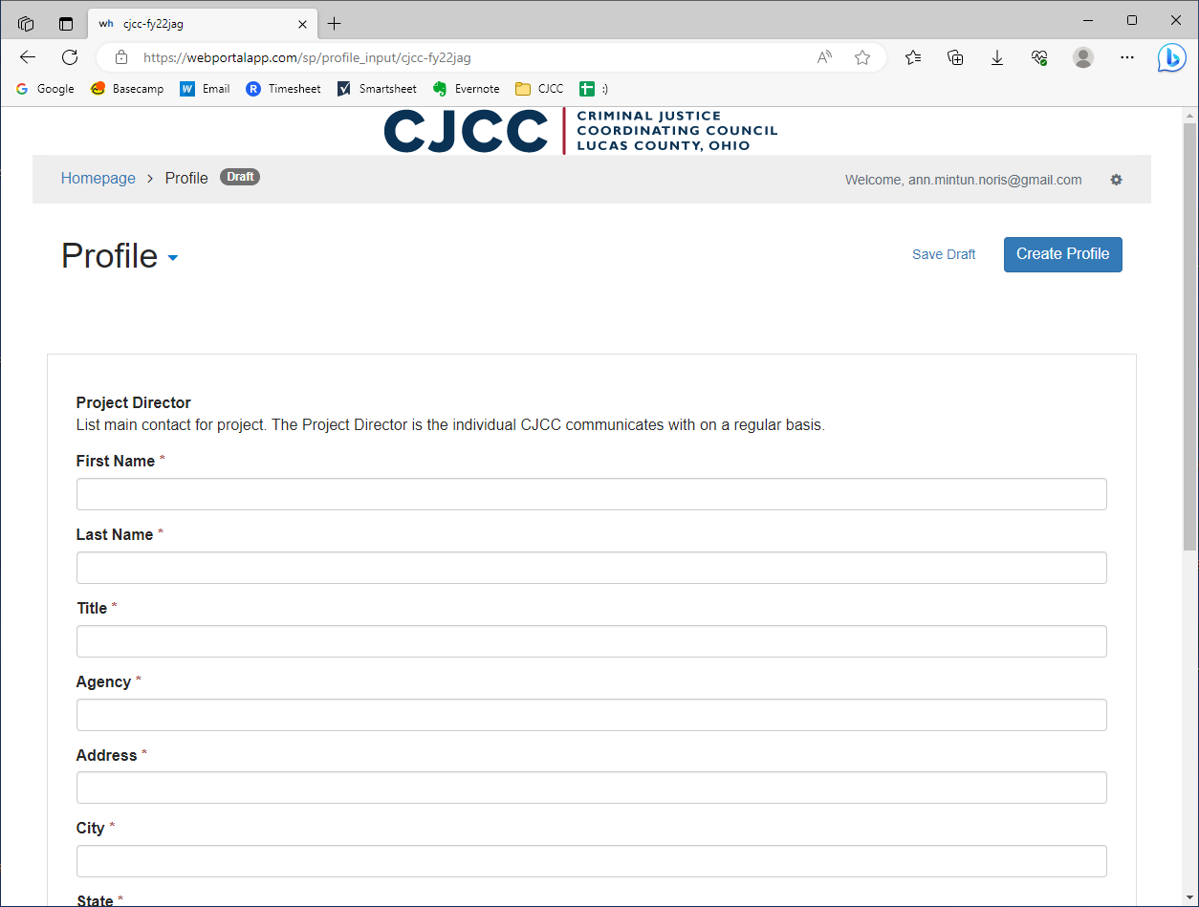
The Application Portal
Notes:
When you create your profile, you’ll fill in all of this information. We want the information for the Project Director, which is the person responsible for coordinating with the CJCC that we will be in contact with regularly.

Slide 17
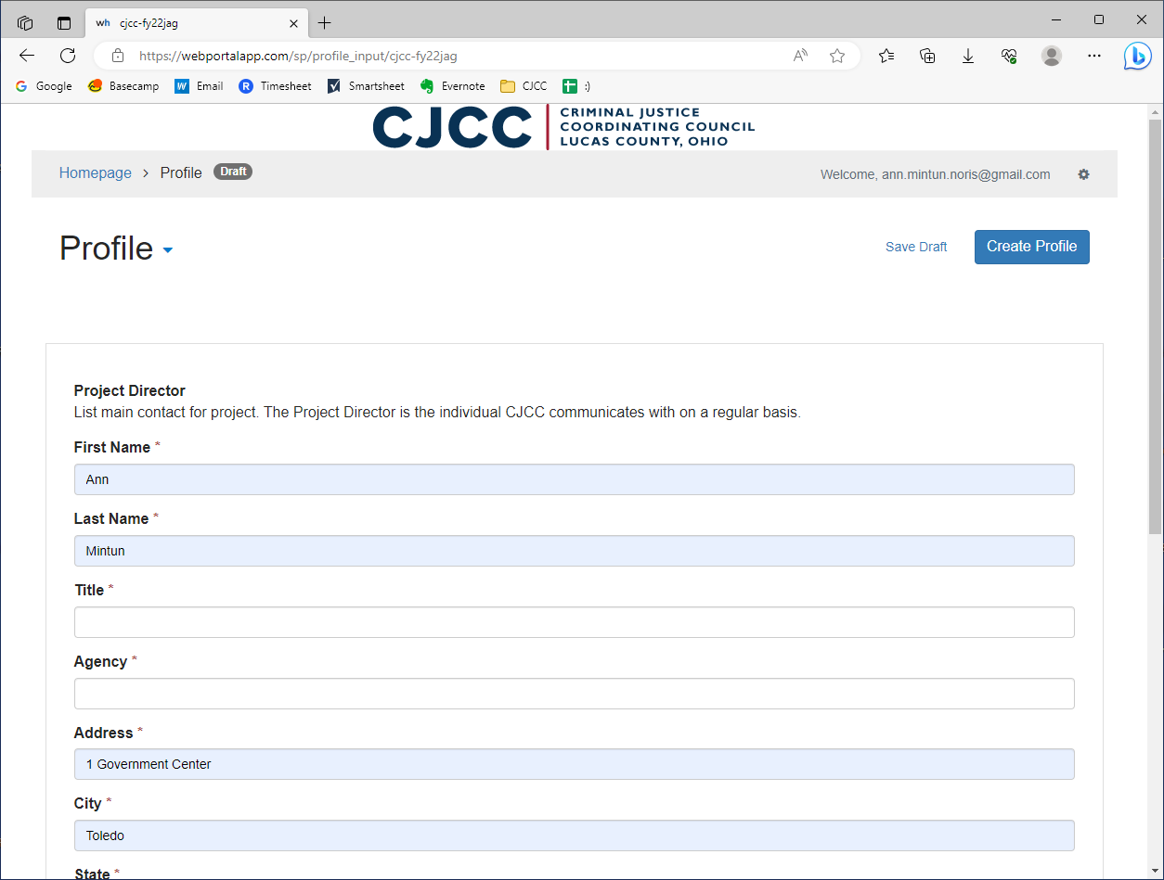
The Application Portal

Slide 18
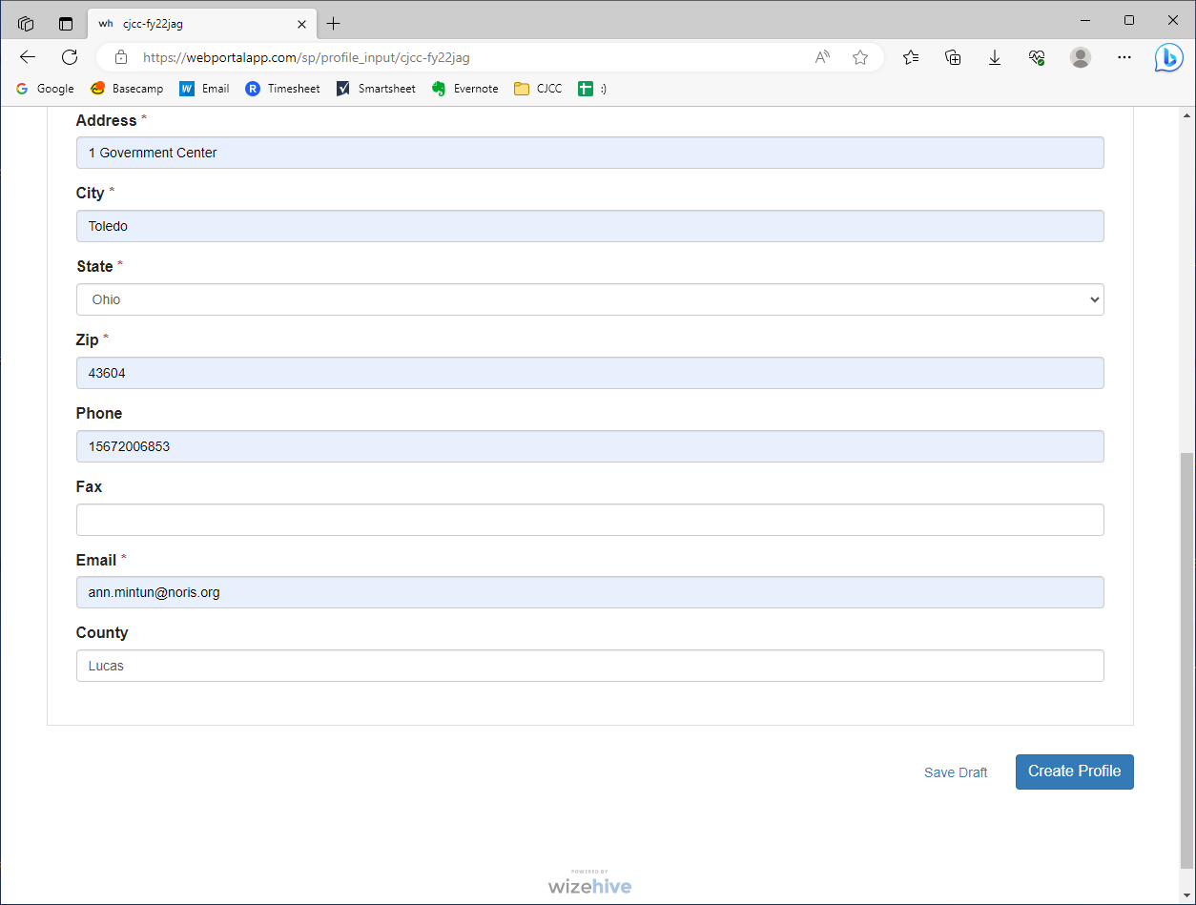
The Application Portal
Notes:
Then go down and click “create profile”

Slide 19
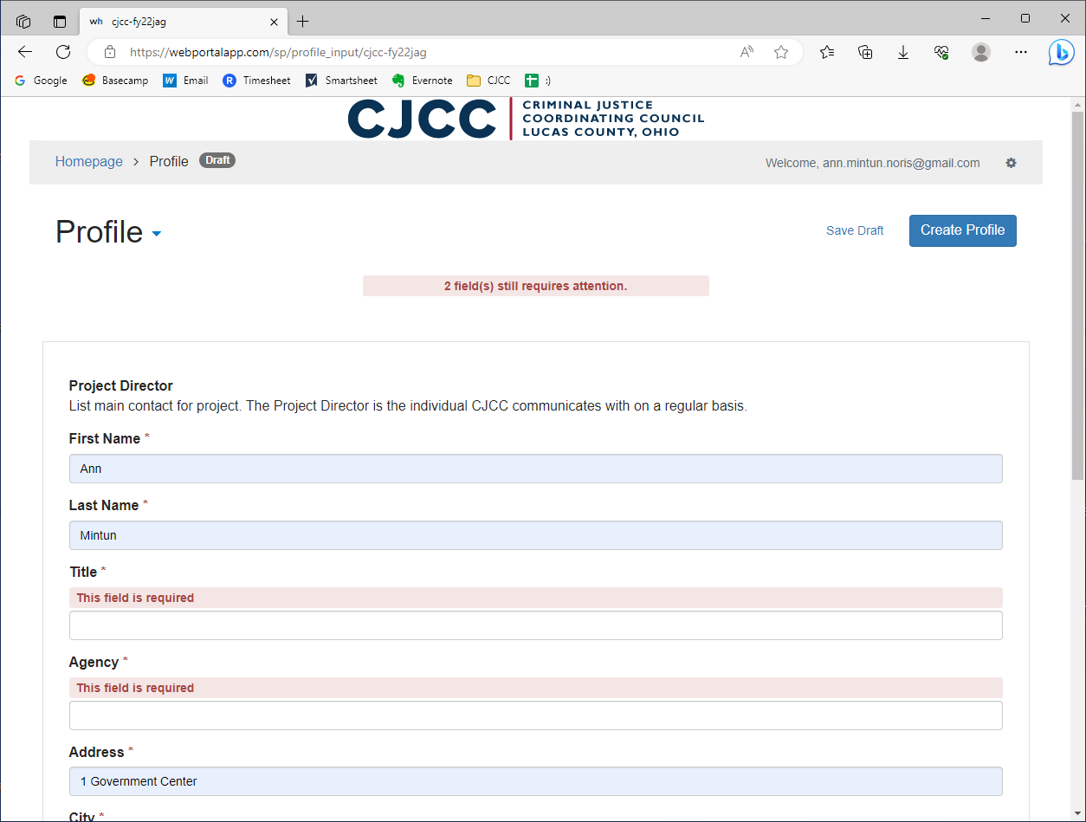
The Application Portal
Notes:
You’ll see this when you create your profile and when you begin your application, but if you submit without filling in required fields, you’ll have to go back and make sure these fields are filled.

Slide 20
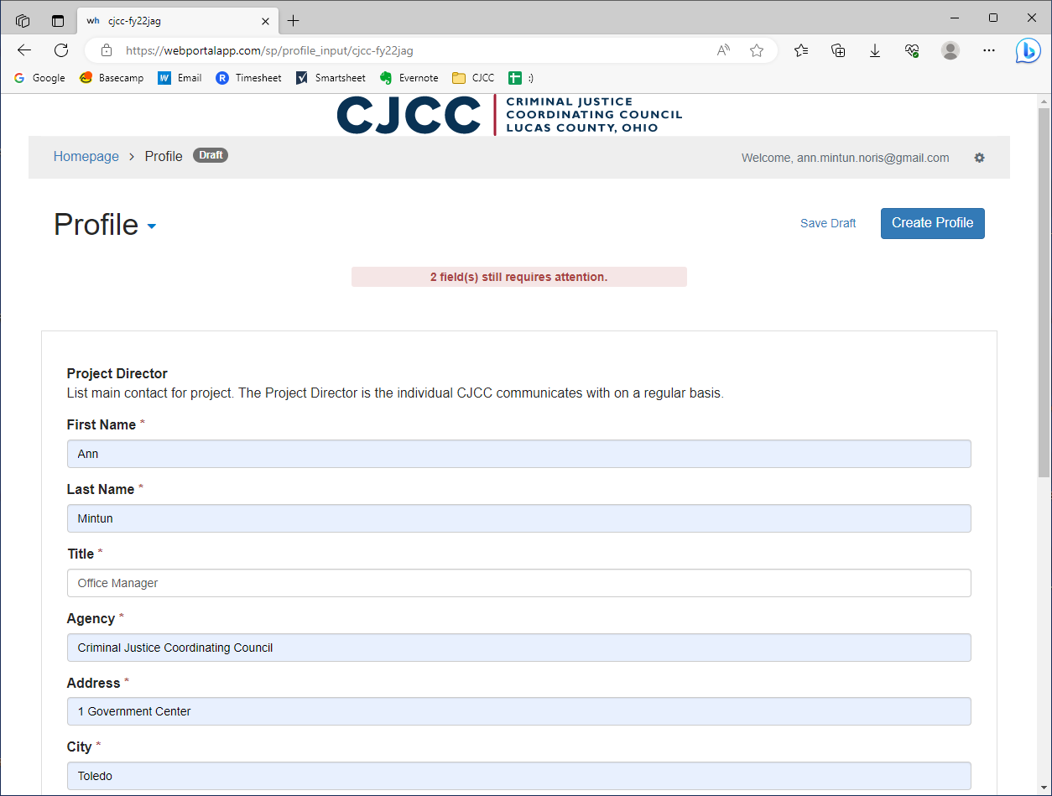
The Application Portal
Notes:
So I’ll go ahead and fill in those fields.

Slide 21
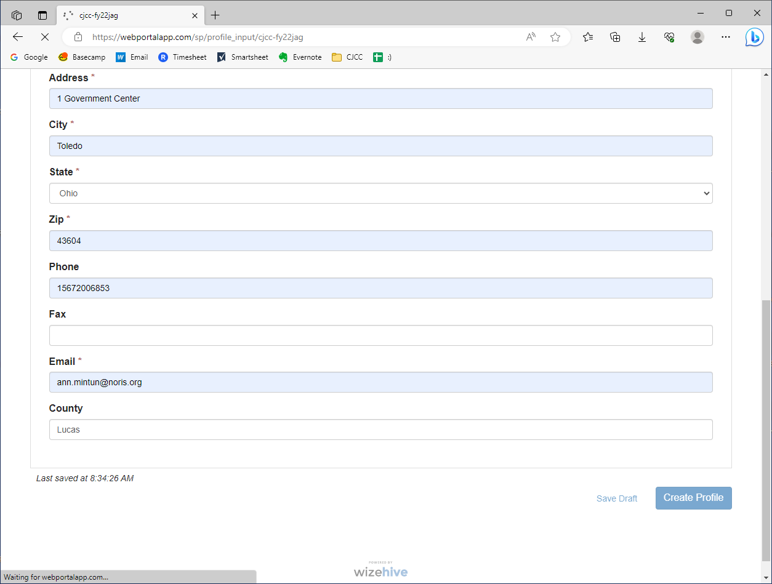
The Application Portal
Notes:
And then submit…

Slide 22
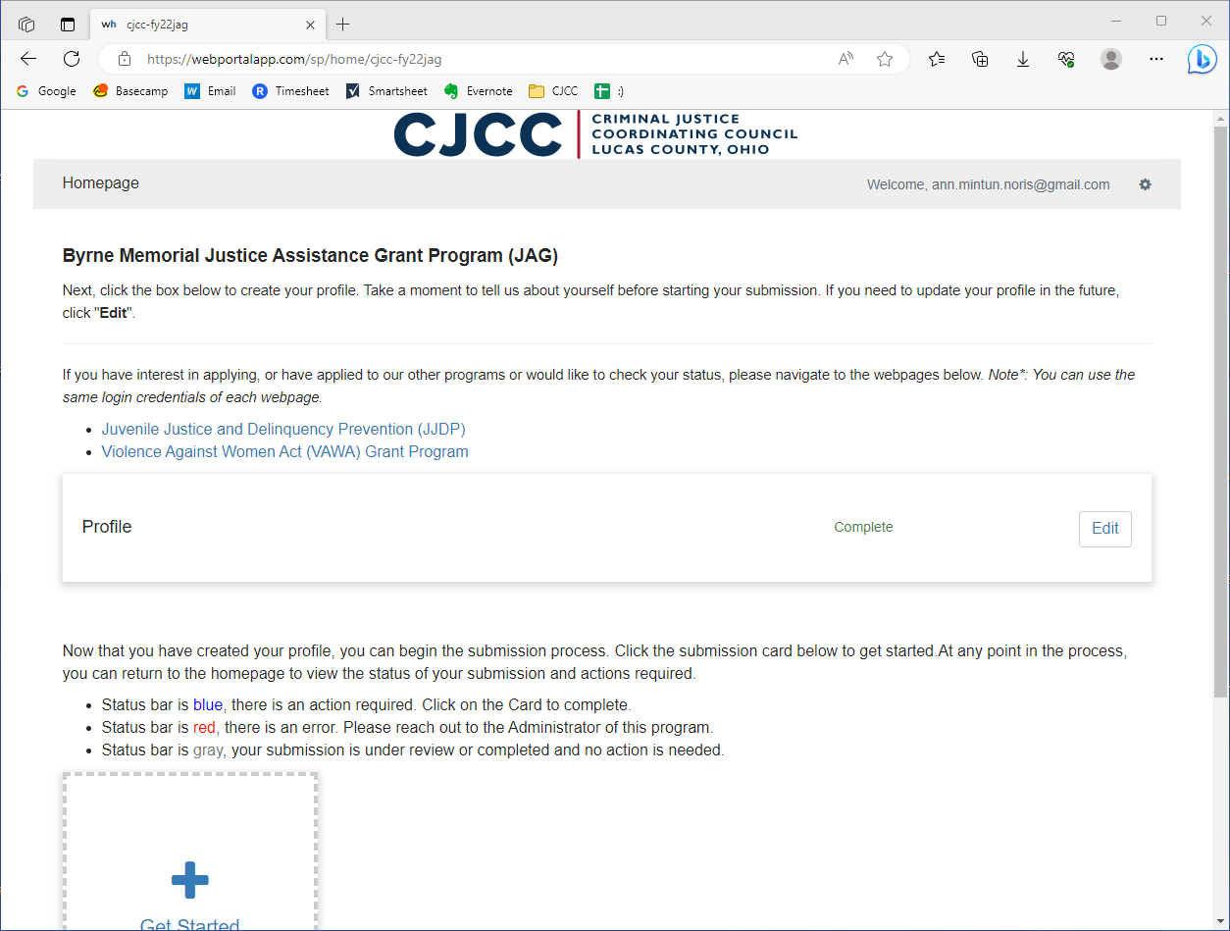
The Application Portal
Notes:
And this takes us here

Slide 23
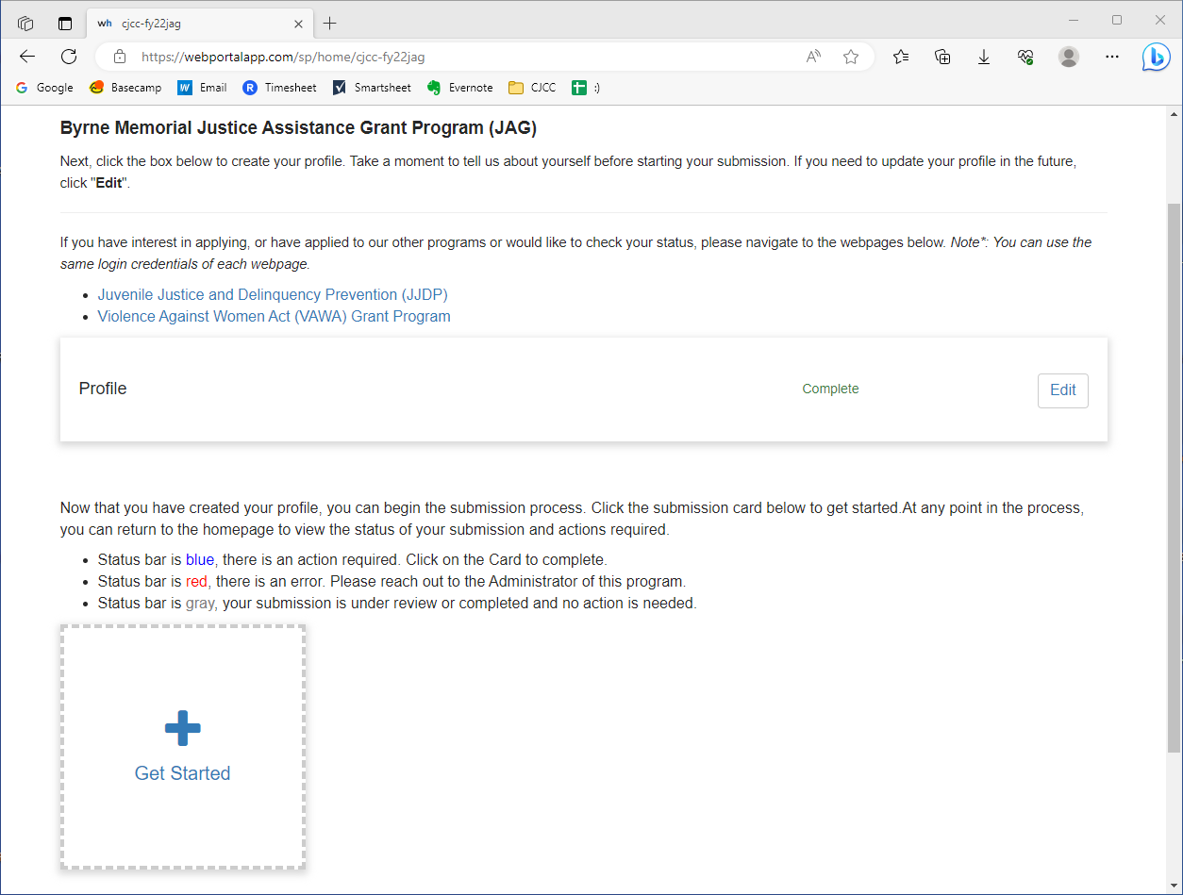
The Application Portal
Notes:
Right now we haven’t begun the application, so we’ll want to click on “Get started” – since we don’t currently have an application, you won’t see these status bars, but we will come back and look at these later.

Slide 24
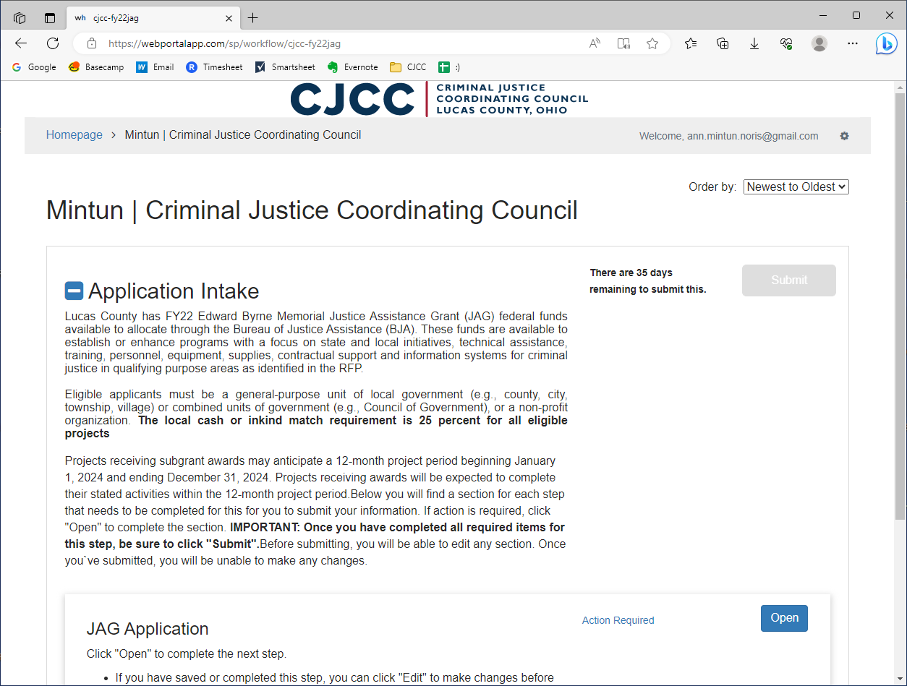
The Application Portal
Notes:
So then this is your application intake page! On this landing page you’ll find an introduction to the grant program you are applying for and other important information you should make sure to read.

Slide 25
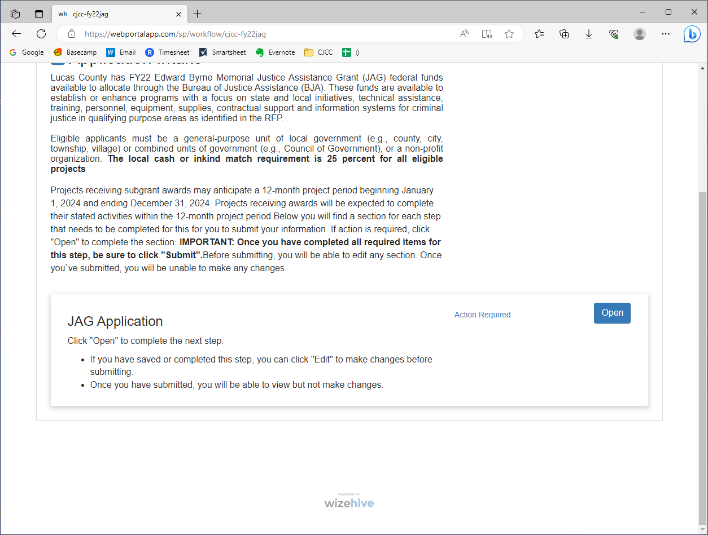
The Application Portal
Notes:
Then you can scroll down, and click “open” to get into the application.

Slide 26
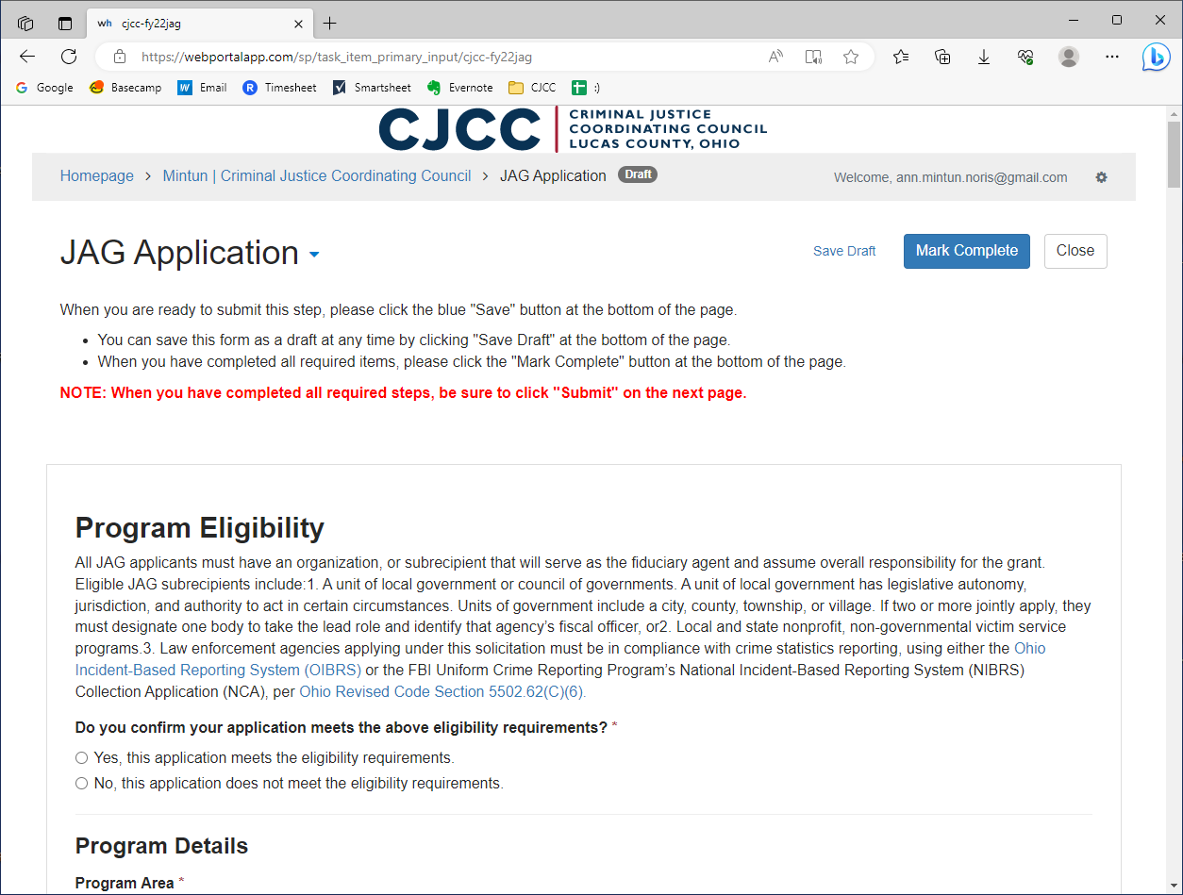
The Application Portal
Notes:
And here is the application!

Slide 27
Application Overview
Notes:
Now I’m just going to briefly “scroll” through the application so you can see what it looks like.

Slide 28
Application Overview
Notes:
This application is for JAG, but VAWA is formatted the same way until we get into the JAG-specific questions.
Program eligibility

Slide 29
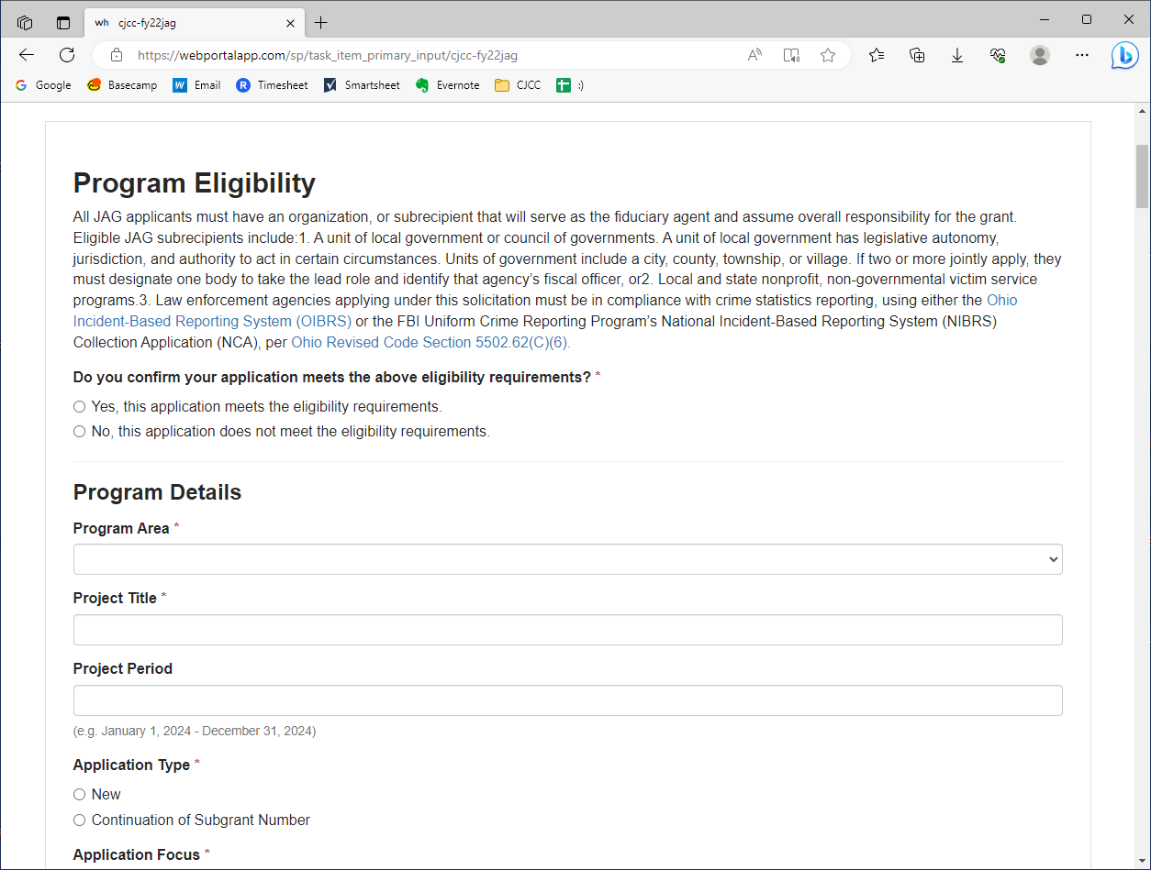
Application Overview

Slide 30
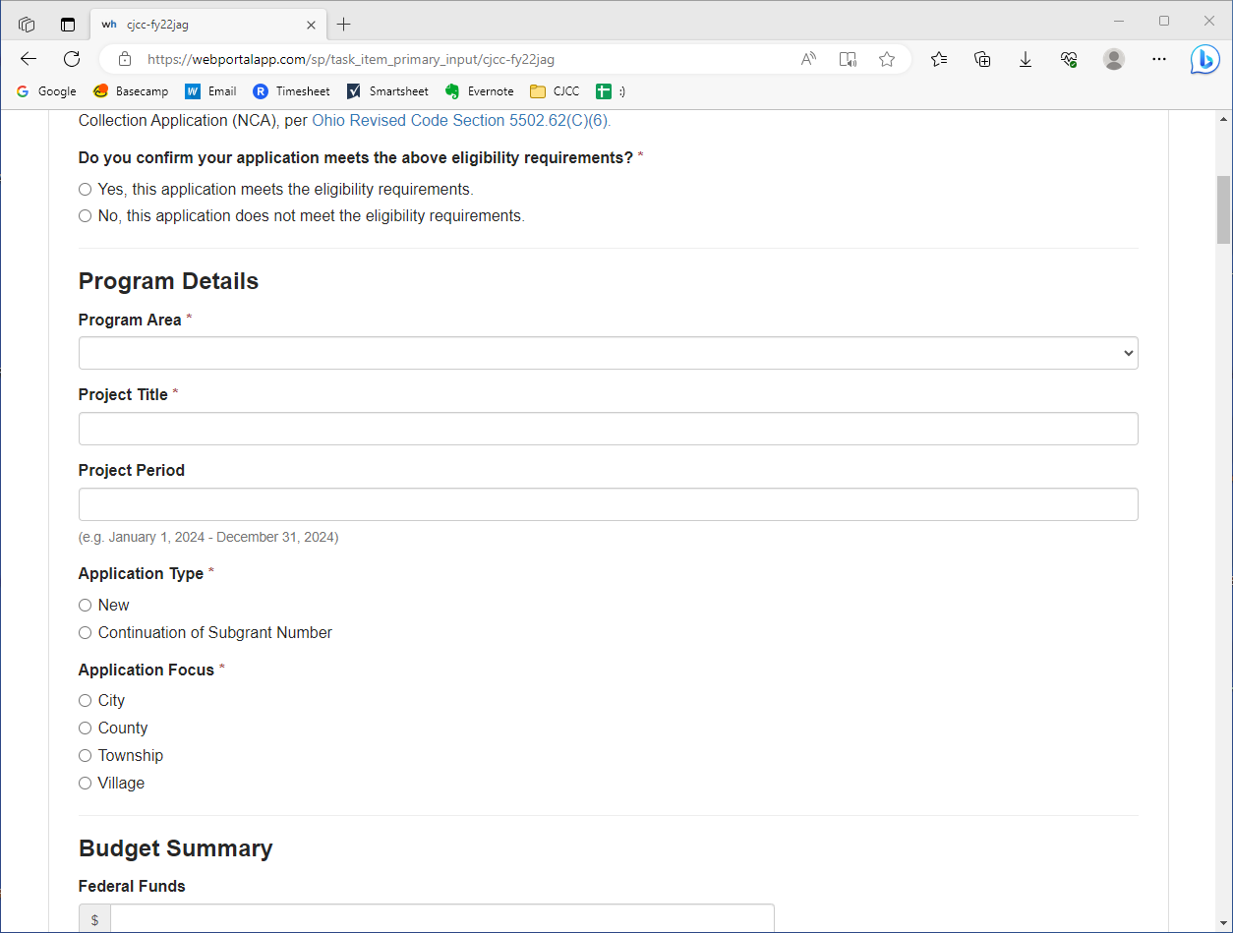
Application Overview
Notes:
Program details

Slide 31
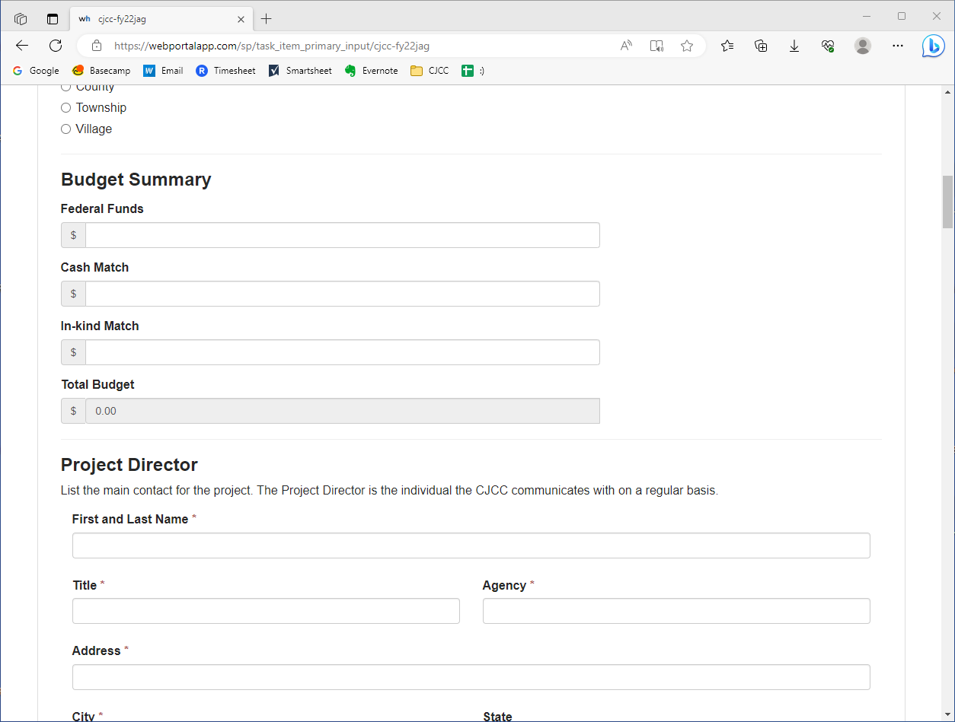
Application Overview
Notes:
Budget summary

Slide 32
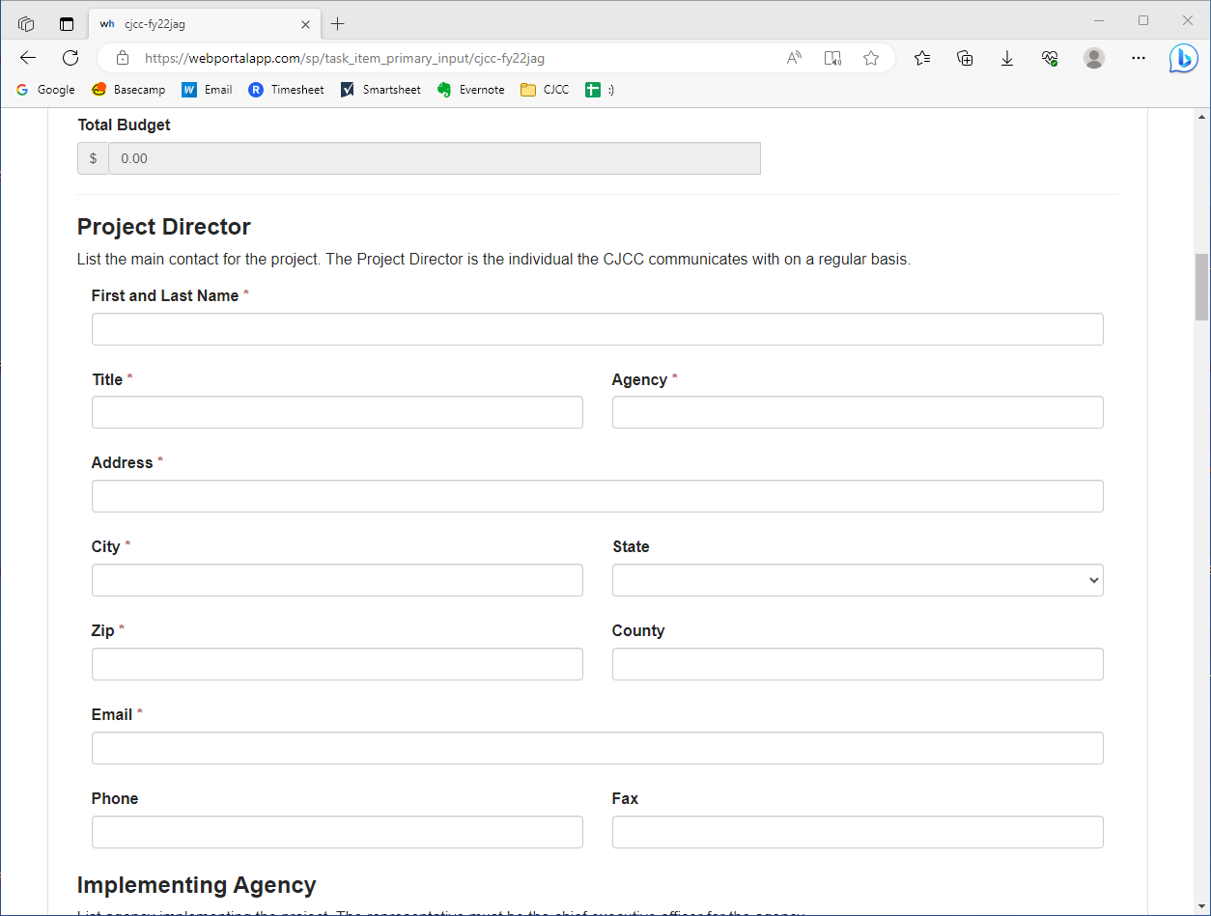
Application Overview
Notes:
Project Director (CJCC’s contact)

Slide 33
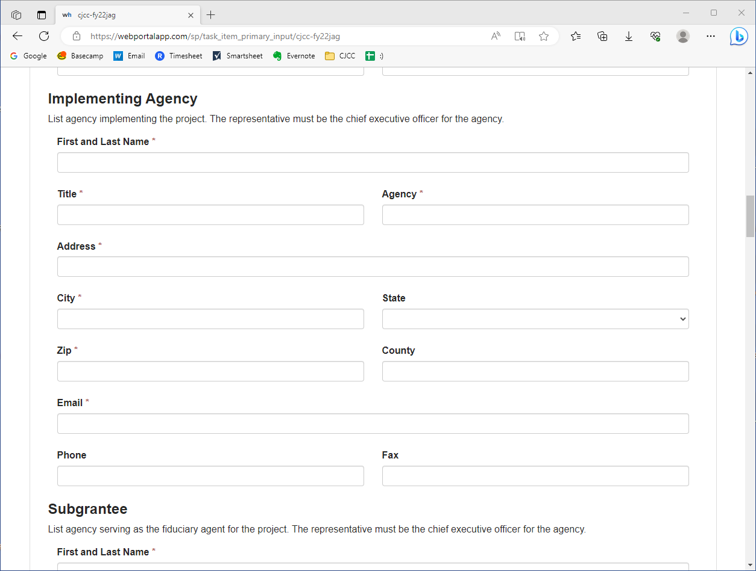
Application Overview
Notes:
Implementing Agency

Slide 34
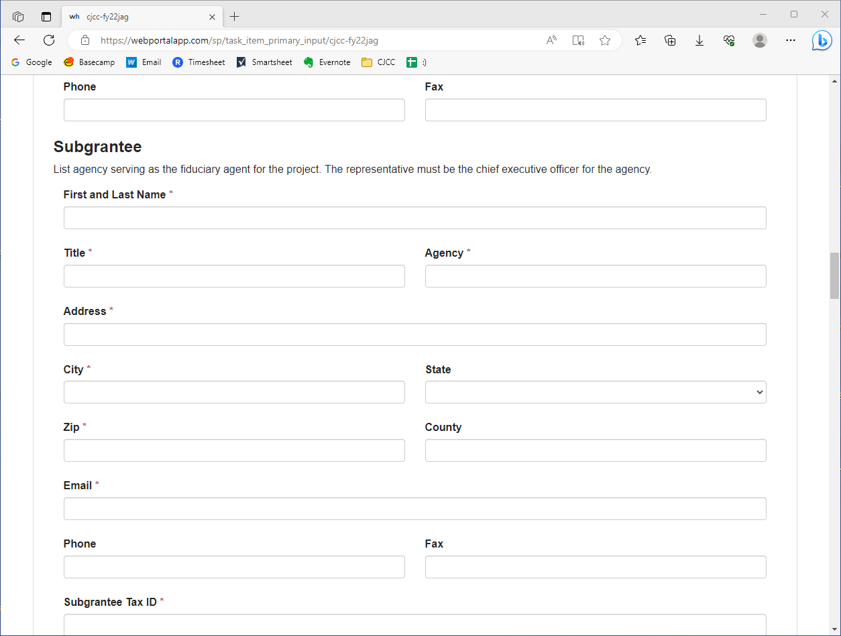
Application Overview
Notes:
Subgrantee

Slide 35
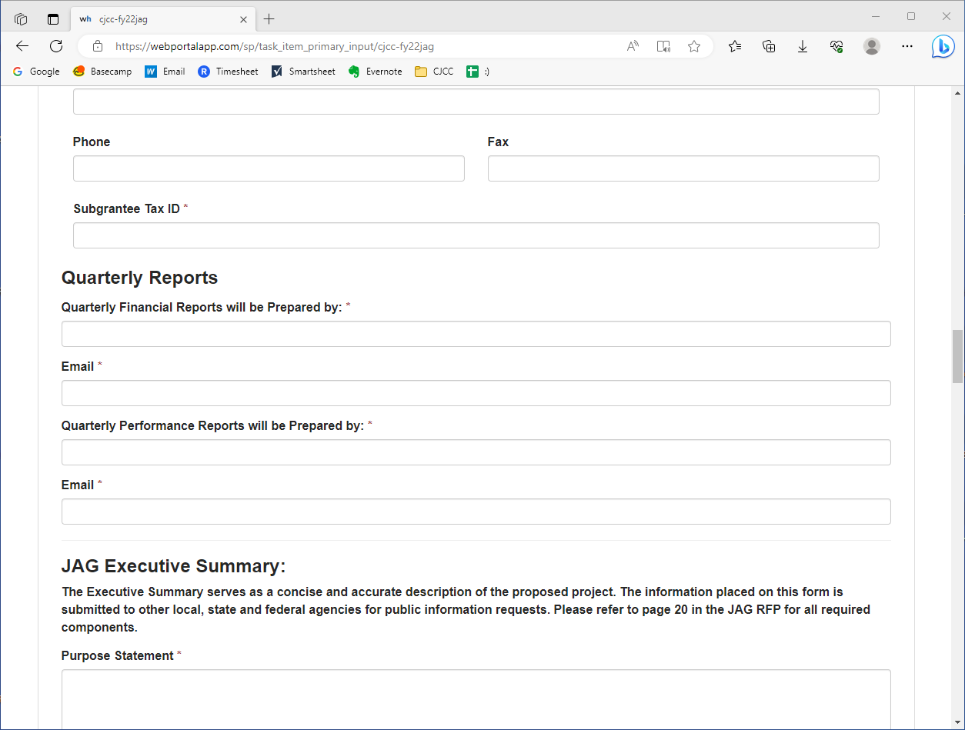
Application Overview
Notes:
Quarterly reports

Slide 36
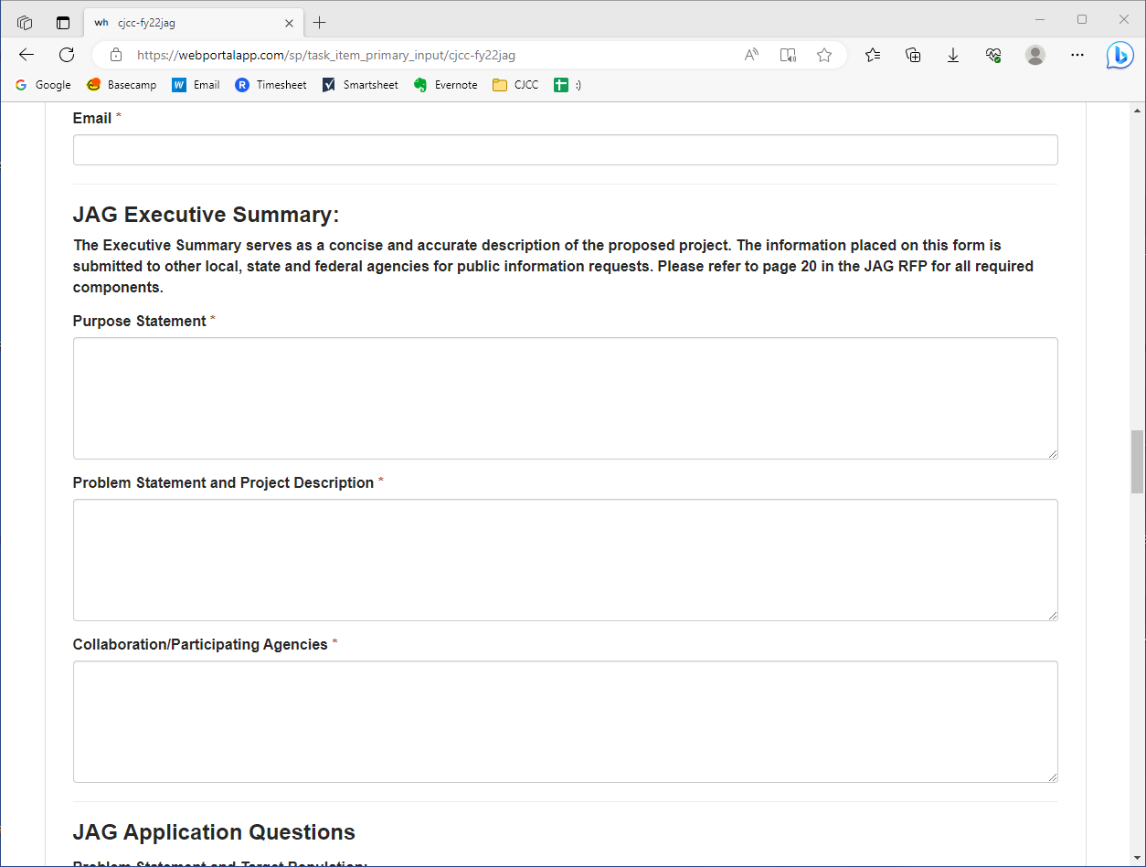
Application Overview
Notes:
Then we get into the JAG-specific area, beginning with the Executive Summary

Slide 37
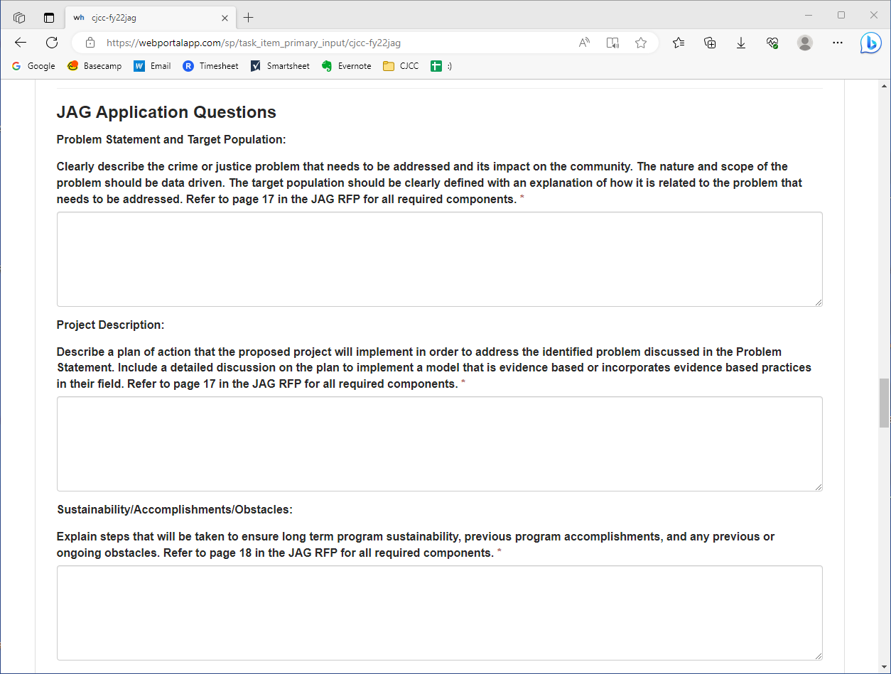
Application Overview
Notes:
Then Application Questions…

Slide 38
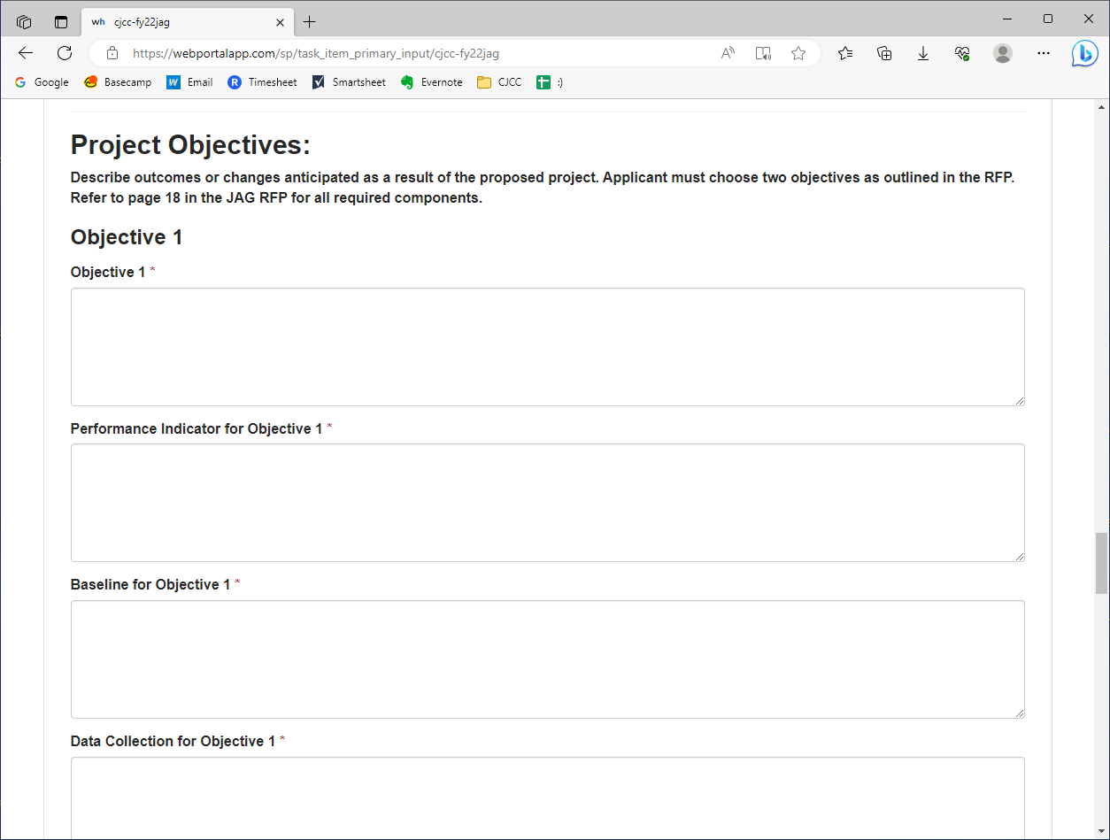
Application Overview
Notes:
Project Objectives…

Slide 39
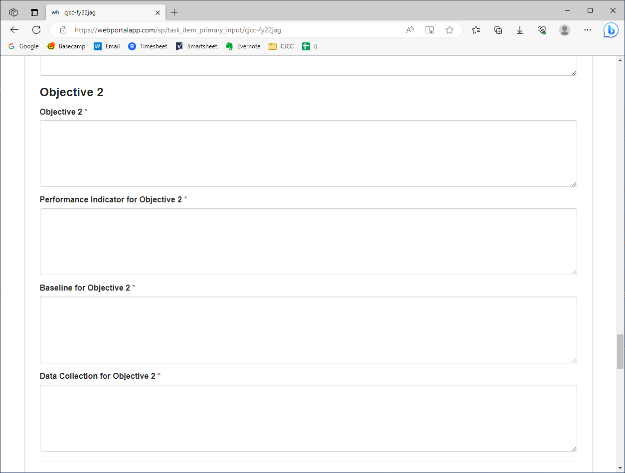
Application Overview

Slide 40
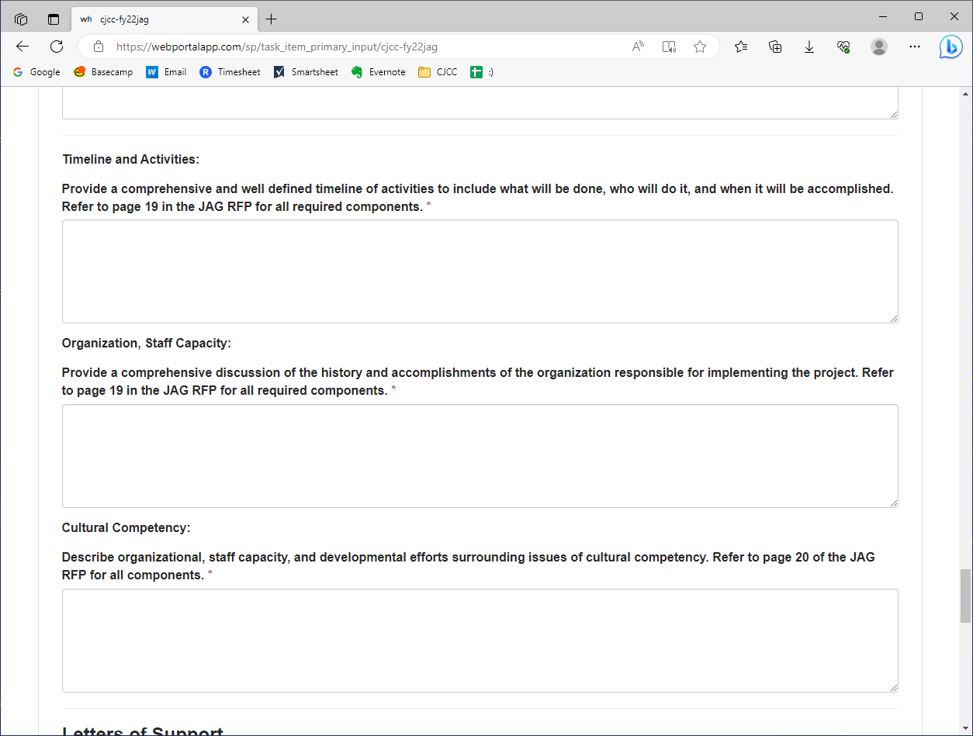
Application Overview
Notes:
Additional components…

Slide 41
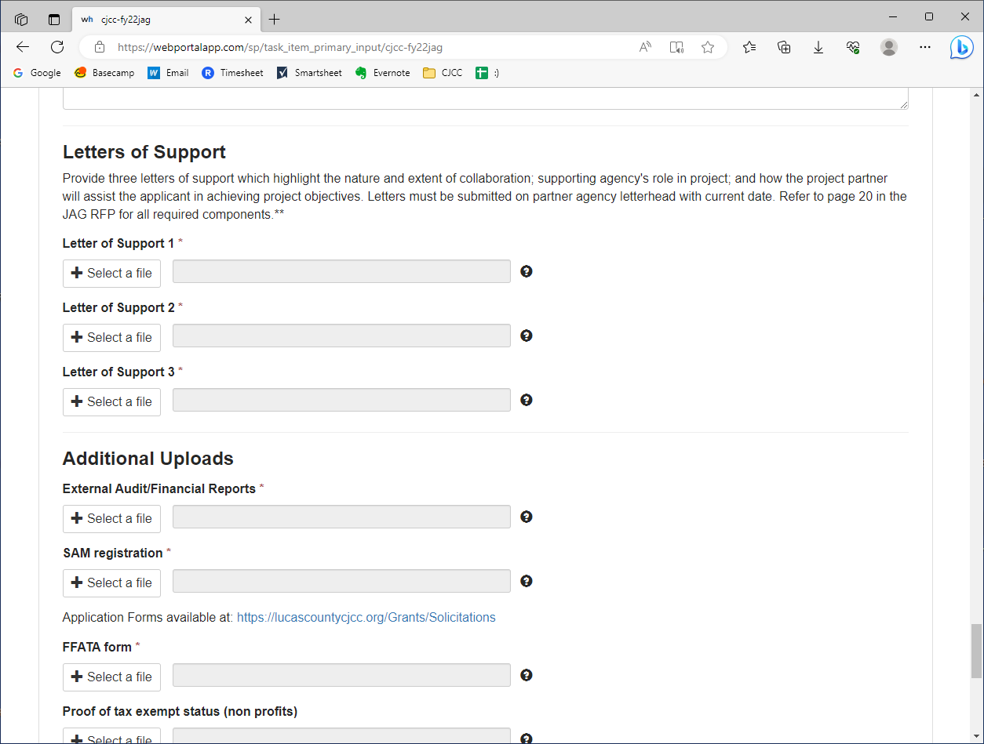
Application Overview
Notes:
Letters of Support…

Slide 42
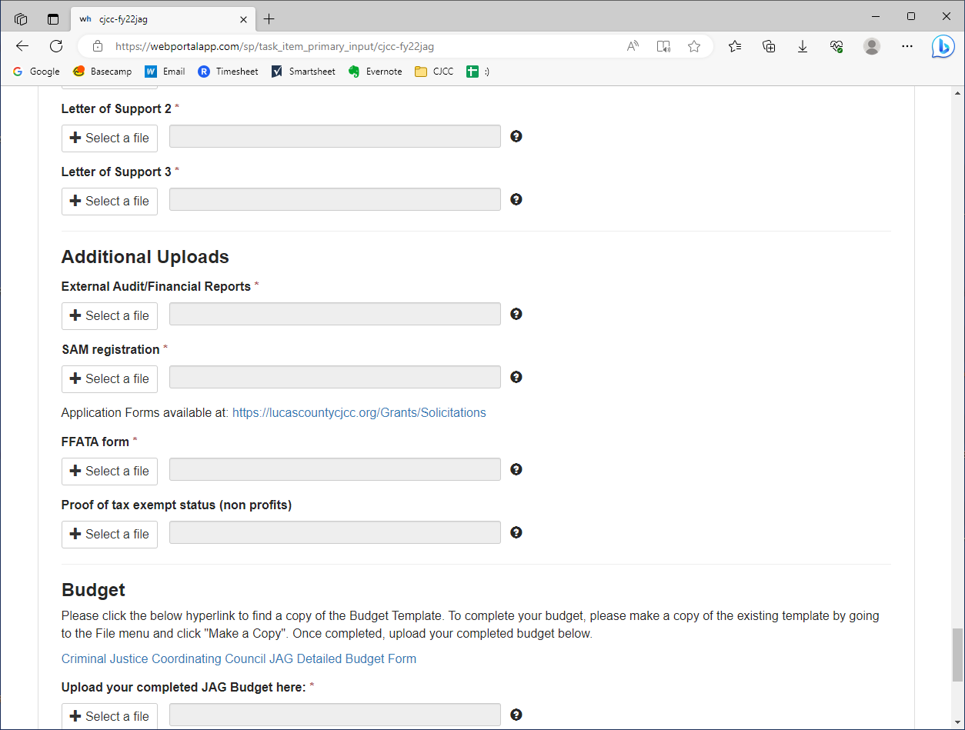
Application Overview
Notes:
Additional Uploads…

Slide 43
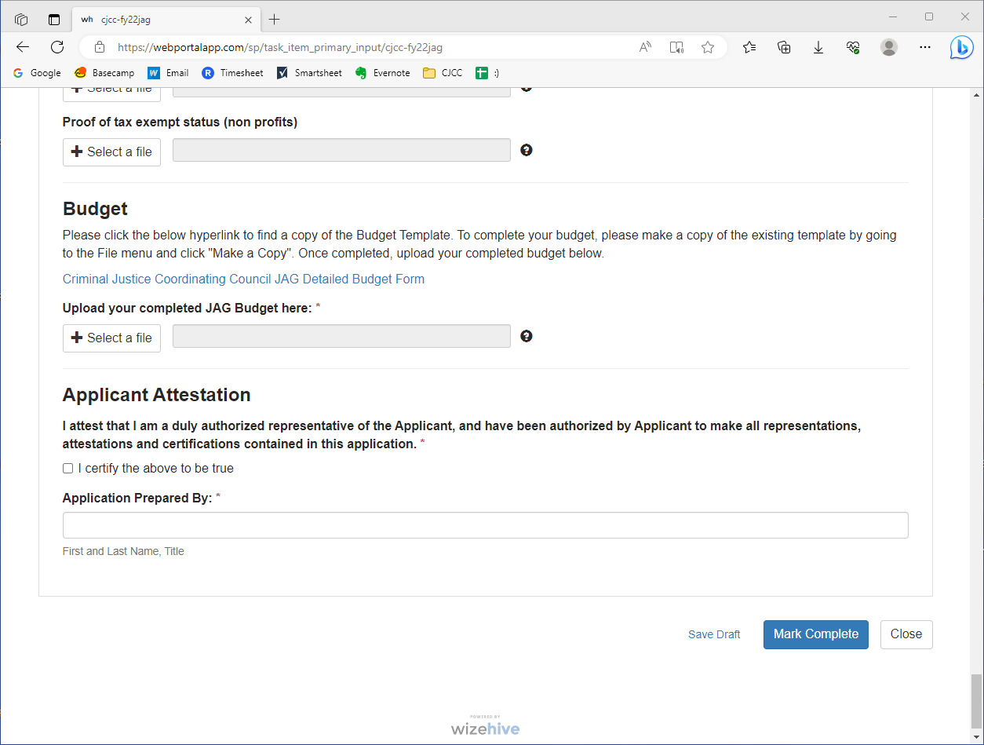
Application Overview
Notes:
And finally the budget

Slide 44
Application Highlights
Notes:
That was a very fast overview, but there are a few things we wanted to highlight about the application and the grant portal that we thought you should know or could potentially be confusing.

Slide 45
Saving Drafts
If you are working on an application in more than one sitting, you can save your work in the application portal (Zengine), then return to it later
Saving Drafts
Notes:
First, we wanted you to be aware that you can save drafts in the portal so you can work on the application in the portal in more than one sitting. To do this…

Slide 46
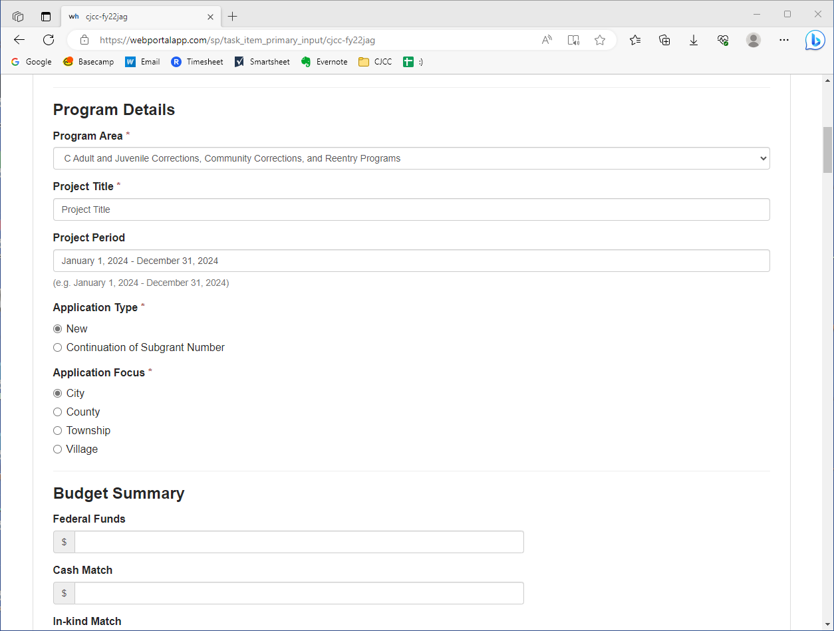
Saving Drafts
Notes:
Let’s say you’re really excited to get into the portal and you start filling out your application. These first few questions are relatively easy…

Slide 47
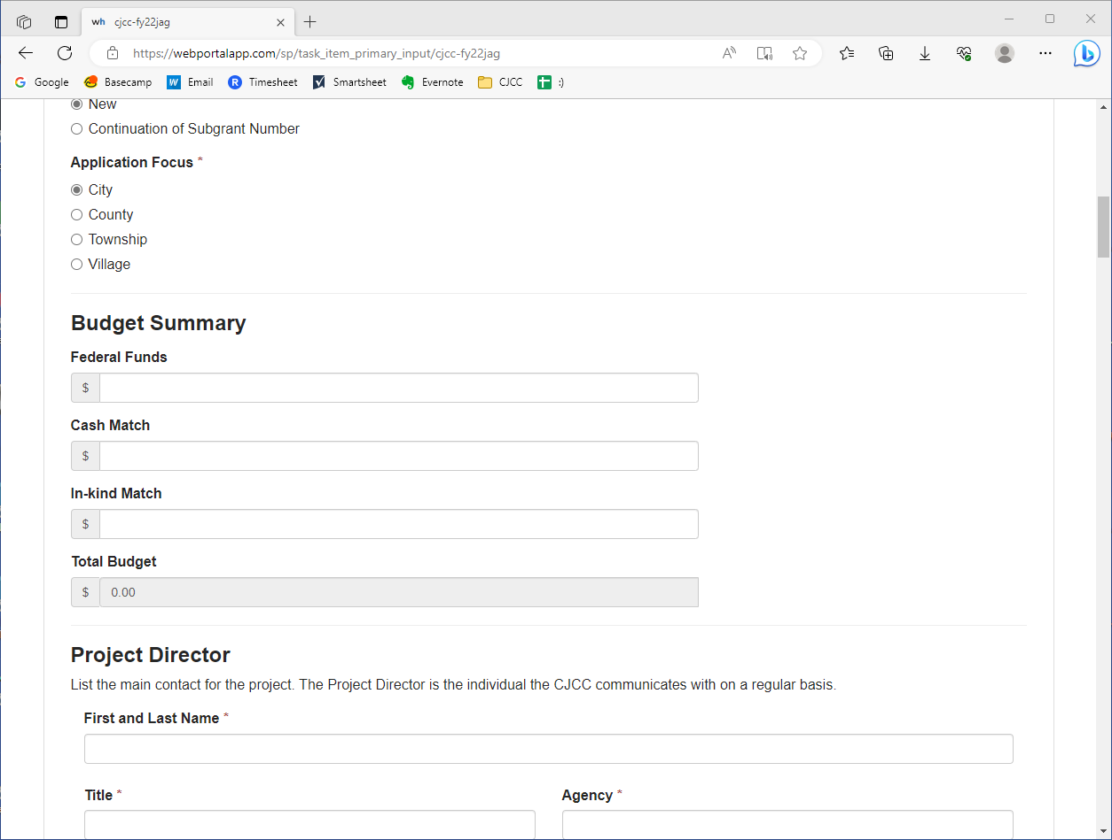
Saving Drafts
Notes:
But then you get to the budget. And all of a sudden your enthusiasm is gone and you realize you have more to do before you can submit this.

Slide 48
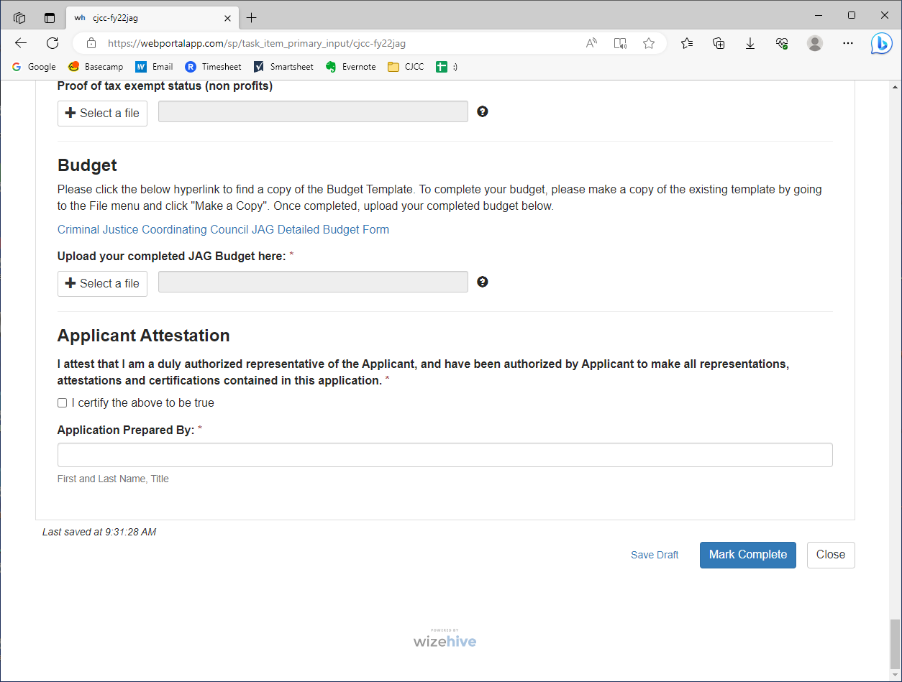
Saving Drafts
Notes:
If you scroll all the way to the bottom on the screen, you can click on “save draft” to save your draft in the system. Before I click it, you’ll notice it says it was last saved at 9:31 AM. But I’ve made changes since then. SO, I’m going to make sure to click on save draft.

Slide 49

Saving Drafts
Notes:
Once I do that, you’ll see the time updates from 9:31 to 9:33.

Slide 50
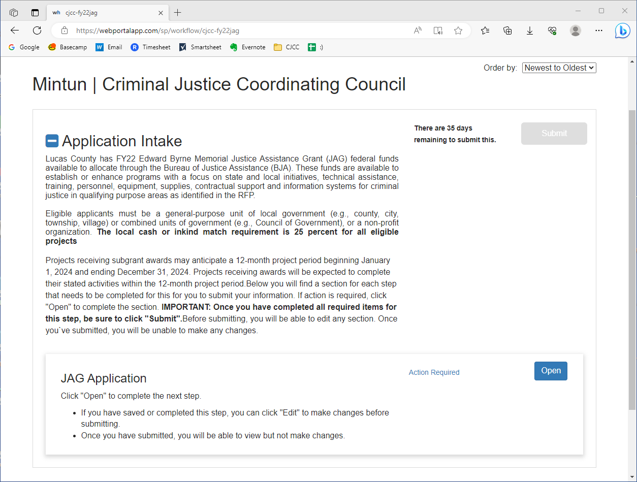
Saving Drafts
Notes:
If I go back to the portal then, you’ll see under application intake it says “action required”. This makes sense because I did not complete my application, I just filled in a few fields. When I do click on “open”, however…

Slide 51
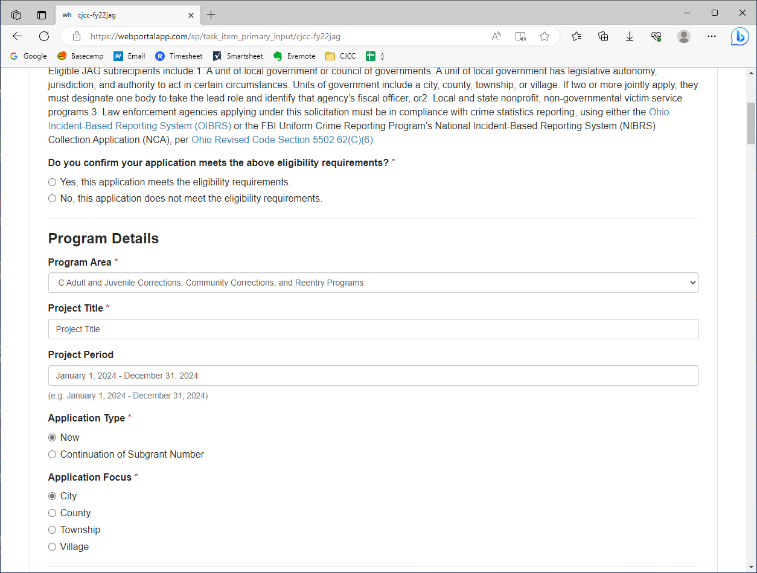
Saving Drafts
Notes:
All of the information I entered earlier and saved is in the portal. So this tool is really helpful if you’re doing your application in pieces, as I’m sure none of you are going to sit down and do this entire application in one sitting.

Slide 52
Uploading the Budget
In order to submit the Budget within your application, you will have to download, fill out, and then upload a form, rather than inputting values directly into Zengine
Notes:
The second thing we wanted to cover was how you can upload your budget, because it is different than how you will input other information.

Slide 53

Uploading the Budget
Notes:
So when you’re within the application, the budget field is at the very end of the form.

Slide 54
Uploading the Budget
Option 1: Microsoft Excel
Option 2: Google Sheets
Notes:
There are two ways to do this: downloading the budget and filling it out through Excel, and making a copy of the budget and filling it out through Google Sheets

Slide 55
Uploading the Budget
Option 1: Microsoft Excel
Option 2: Google Sheets
Notes:
First, let’s go over option 1: Microsoft excel

Slide 56
Uploading the Budget: Option 1 (Excel)
Notes:
First, click on the budget form within the application portal.

Slide 57
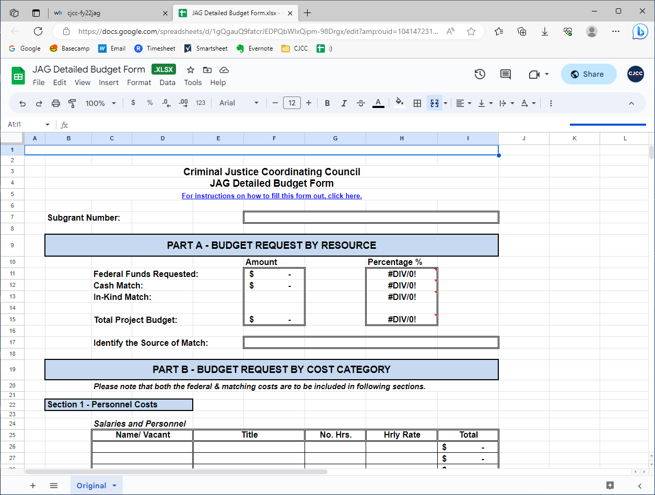
Uploading the Budget: Option 1 (Excel)
Notes:
This screen should pop up. You’re going to want to go to “File”…

Slide 58
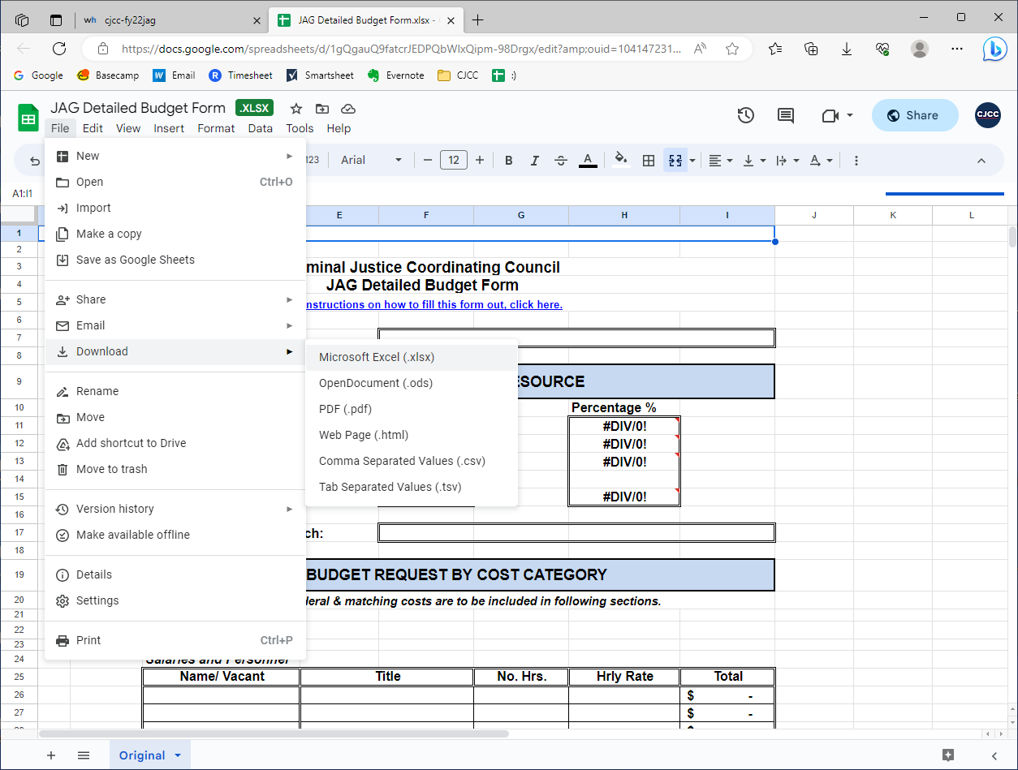
Uploading the Budget: Option 1 (Excel)
Notes:
Then “download”, then “Microsoft excel”

Slide 59
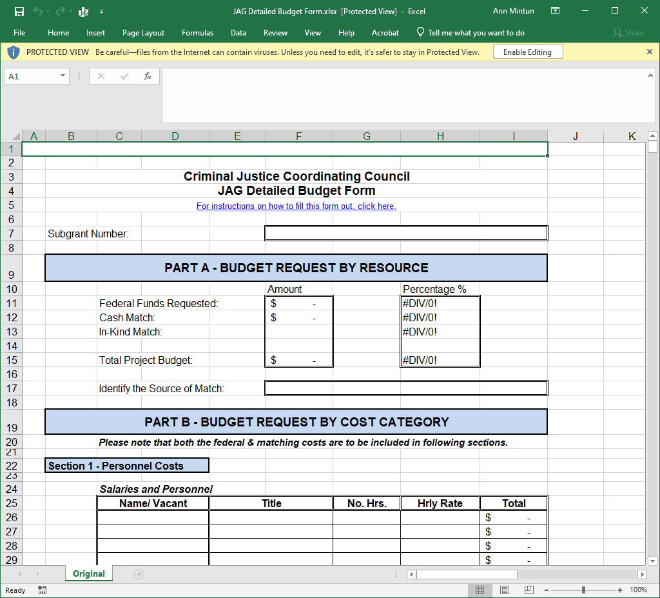
Uploading the Budget: Option 1 (Excel)
Notes:
After the form downloads, you can open it in excel

Slide 60
Uploading the Budget: Option 1 (Excel)
Notes:
Part A will automatically calculate after you input information in the parts below. So, you DO NOT want to touch Part A. Skip it and move down to part B.

Slide 61
Uploading the Budget: Option 1 (Excel)
Notes:
Part A will automatically calculate after you input information in the parts below. So, you DO NOT want to touch Part A. Skip it and move down to part B.

Slide 62
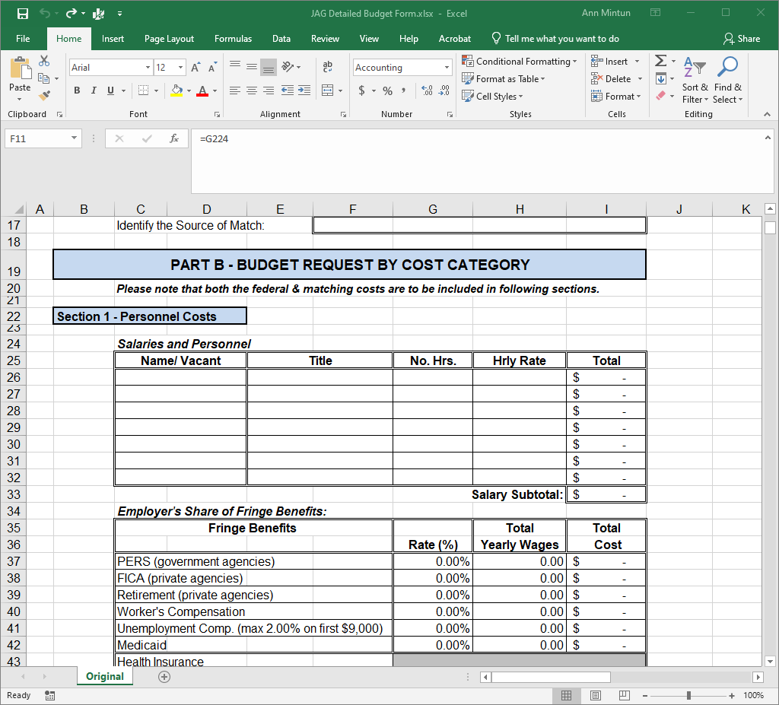
Uploading the Budget: Option 1 (Excel)
Notes:
So here’s Part B. You’ll want to go ahead and fill this in.

Slide 63
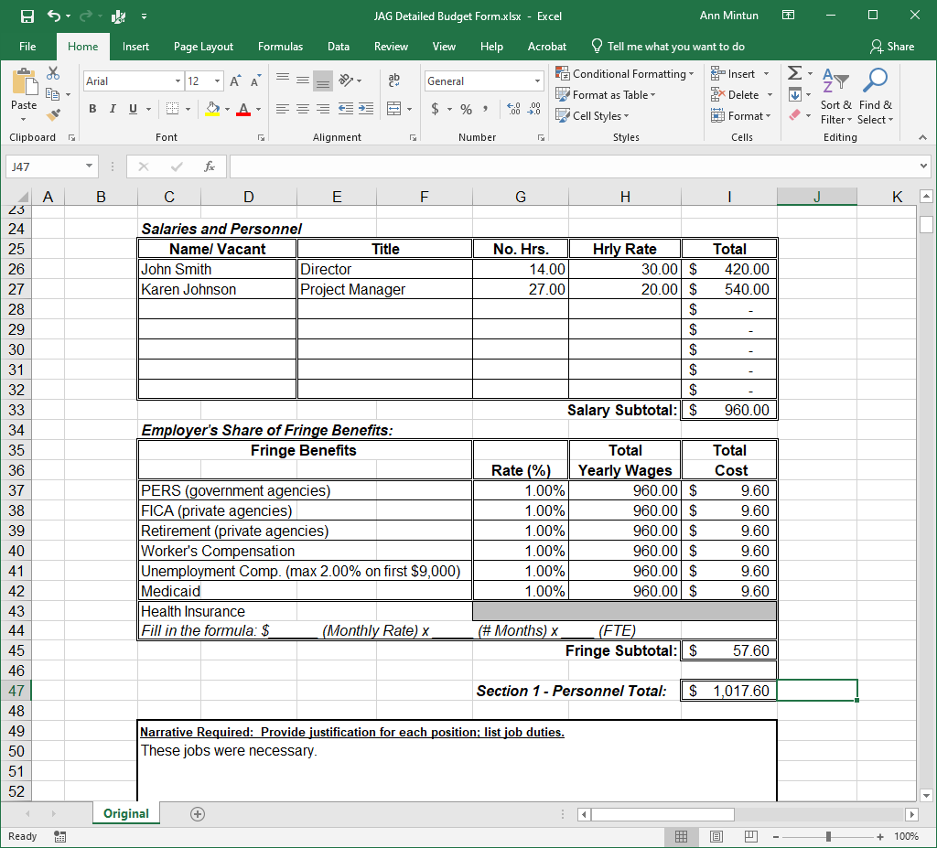
Uploading the Budget: Option 1 (Excel)
Notes:
And then once it is filled in, if you scroll back up….

Slide 64
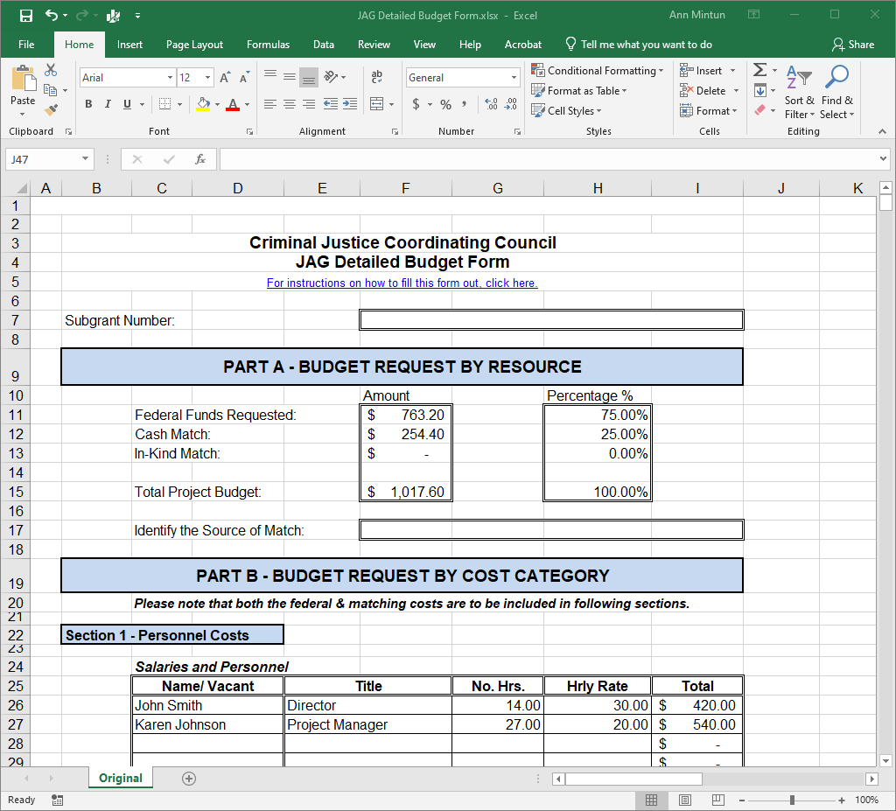
Uploading the Budget: Option 1 (Excel)
Notes:
And that will calculate. Obviously I didn’t fill out the match portion of the form, but you get the point. Make sure to save your work as you go. Once you are done, save it one last time, then go back to the application portal.

Slide 65
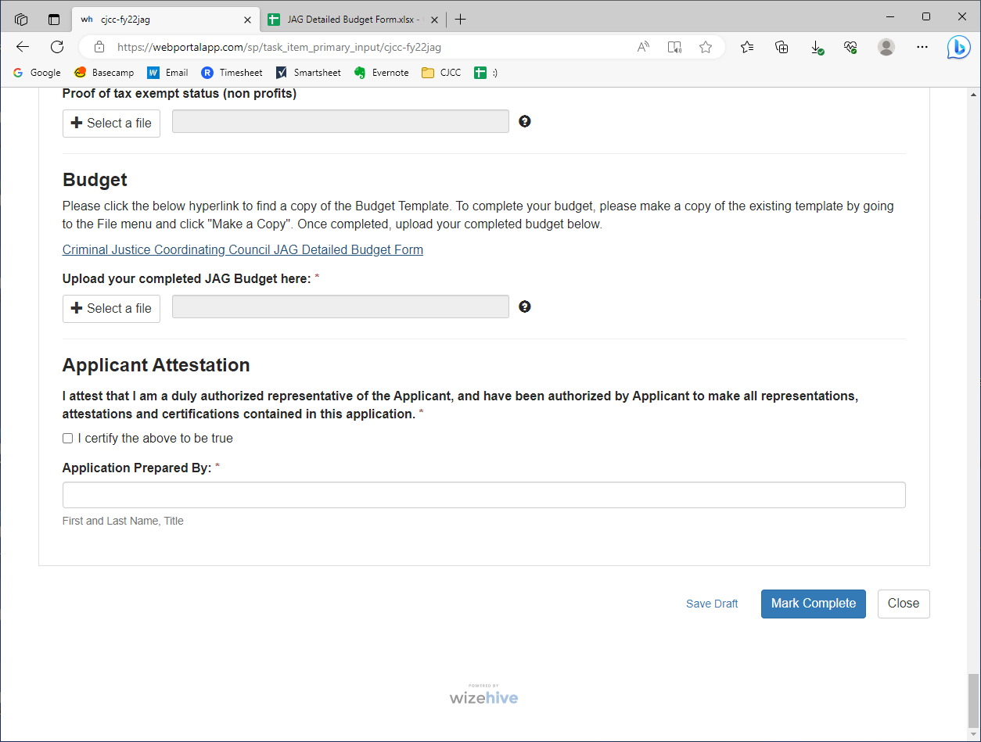
Uploading the Budget: Option 1 (Excel)
Notes:
Then “select a file”

Slide 66
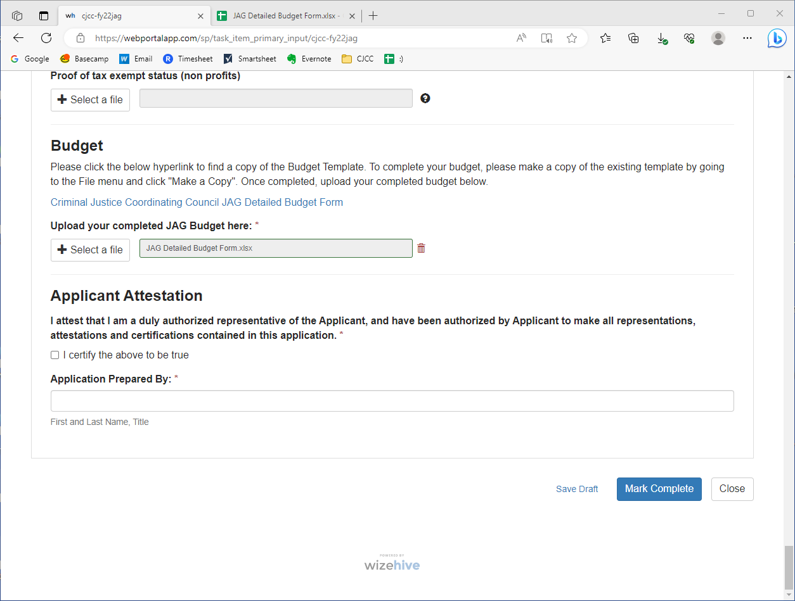
Uploading the Budget: Option 1 (Excel)
Notes:
And add your file. Once it is here, you are all set.

Slide 67
Uploading the Budget
Option 1: Microsoft Excel
Option 2: Google Sheets
Notes:
Option 2 is very similar, but this would be if you wanted to fill out the form through Google Sheets

Slide 68
Uploading the Budget: Option 2 (Google Sheets)
Notes:
So, once again we are starting from the Budget area of the form. You’ll want to click on the form.

Slide 69
Uploading the Budget: Option 2 (Google Sheets)
Notes:
This screen should pop up. And this is google sheets. But, we made this form “view only”, so you won’t be able to edit it unless you make a copy. To make your own version of this form and fill it in, you want to make a copy of it. To do this, you’re going to go to “File”…

Slide 70
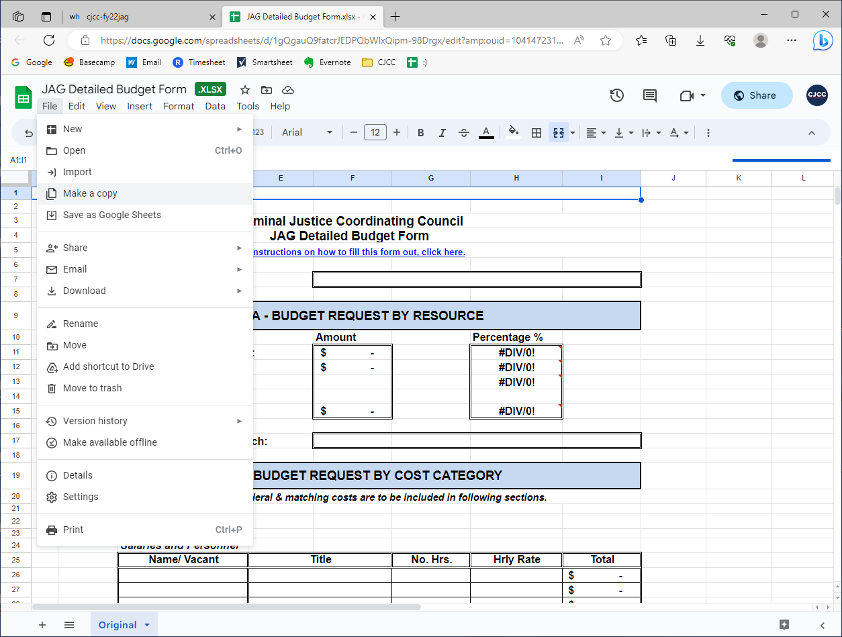
Uploading the Budget: Option 2 (Google Sheets)
Notes:
Then “Make a copy”

Slide 71
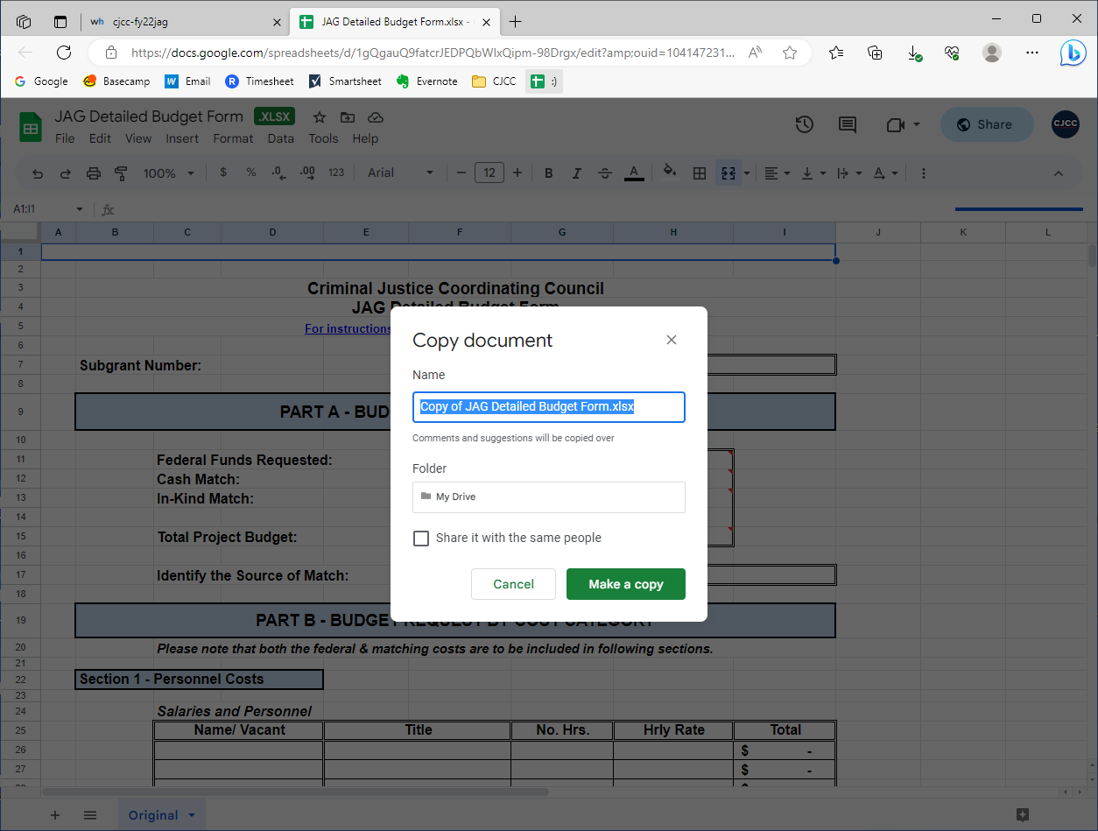
Uploading the Budget: Option 2 (Google Sheets)
Notes:
Then this screen will pop up. Go ahead and name the document however you like –

Slide 72

Uploading the Budget: Option 2 (Google Sheets)
Notes:
I’m just going to name it my name. Then I’m going to click “Make a copy”

Slide 73

Uploading the Budget: Option 2 (Google Sheets)
Notes:
Then a new tab will open, and you will be able to edit the form and fill in your budget information.

Slide 74
Uploading the Budget: Option 2 (Google Sheets)
Notes:
I’m not going to go over this part again, but again you don’t want to touch part a as this will automatically calculate when you fill out the other fields. So go ahead and skip it, and move on to Part B and go through and fill in your information for sections 1 through 8.

Slide 75
Uploading the Budget: Option 2 (Google Sheets)
Notes:
Once you’re done, you’ll want to go up to File….

Slide 76
Uploading the Budget: Option 2 (Google Sheets)
Notes:
Then “download”, then “Microsoft excel”. This will save the file to your downloads. So you can then go back to the grant management portal…

Slide 77
Uploading the Budget: Option 2 (Google Sheets)
Notes:
Then “select a file”. Your file should be saved in your downloads.

Slide 78
Uploading the Budget: Option 2 (Google Sheets)
Notes:
And add your file. Once it is here, you are all set.

Slide 79
Application Tips

Slide 80
Print the Application Before Starting
This will allow you to see and review all the questions in order to plan out your application
Application Tips

Slide 81
Application Tips

Slide 82

Application Tips

Slide 83
Work on Your Application in Word or Google Drive
While you can save drafts in Zengine, working from a reliable software like Word or Google Drive will ensure if the internet stops working, you won’t lose your work
If you are collaborating with others, you can share the document with teammates (but still have control over what is submitted)
Application Tips

Slide 84

Application Tips

Slide 85

Application Tips

Slide 86

Application Tips

Slide 87

Application Tips

Slide 88

Application Tips

Slide 89

Application Tips

Slide 90
Submitting the Application
Notes:
Finally, let’s go over submitting your application…

Slide 91

Submitting the Application
Notes:
Go ahead and click “mark complete”

Slide 92

Submitting the Application
Notes:
Upon submission, you will be taken back to the application intake page. But if you scroll down…

Slide 93

Submitting the Application
Notes:
You’ll notice this now says complete

Slide 94
Submitting the Application
Notes:
If you want to make changes to the application, you can by clicking “edit”

Slide 95

Submitting the Application
Notes:
The application will open up like it always does. Just make sure that if you do make changes, you save them and then, eventually, submit the changes.

Slide 96
CJCC Communication
Notes:
Finally, let’s go over communication from the CJCC…

Slide 97

CJCC Communication
Notes:
When CJCC staff opens your application to review it, you will receive this email as confirmation. If you go back into the grant portal…

Slide 98

CJCC Communication
Notes:
you will see the status of your application has changed. Now, your application will be “under review”.

Slide 99

Specific Feedback
CJCC Communication
Notes:
After our staff review, there may be mistakes that need to be fixed. We will communicate this to you via email, and that email will look like this. In this email, the CJCC asked for me to make some changes to my application. Where this red box is, this is where you will get specific feedback to your application. So this feedback says “please change fields from “a” to Project Director information. So I’m just going to click on the link here to go to the submission portal…

Slide 100

CJCC Communication
Notes:
You’ll see that instead of saying “under review” your application says “application intake”. Let’s click on that.

Slide 101

CJCC Communication
Notes:
This is going to take us here. You will notice, when we scroll down, that it says “complete”. This makes sense, because we did complete the application. But – we want to make the changes the CJCC requested. So let’s click edit.

Slide 102

CJCC Communication
Notes:
This brings us into the application again. Now, in the email it said to change fields from “a” to Project Director information. So I’m going to scroll to Project Director information…

Slide 103

CJCC Communication
Notes:
And, sure enough, I didn’t submit information for my project director, every field says a. So let me fix this….

Slide 104

CJCC Communication
Notes:
now that I have made these corrections, I’m going to scroll all the way down...

Slide 105

CJCC Communication
Notes:
And click on save changes

Slide 106
Project Presentations
DEADLINE:
August 7, 2023
@ 4:00 PM
Notes:
So, after staff reviews your application and we reach out IF we would like to request any changes to your application, every application will receive an email from us to submit a project presentation. Project presentations are videos that are no longer than 5 minutes which explain your project.

Slide 107

Project Presentation
Notes:
So you will get this email inviting you to submit your project presentation video. We’re going to click on this link…

Slide 108

Project Presentation
Notes:
Which takes us back here! Note that the status has changed again, and now says “Project Presentation Video” – let’s click on it

Slide 109

Project Presentation
Notes:
And notice on the application landing page there is a new page called Project Presentation Intake… let’s click on this.

Slide 110

Project Presentation
Notes:
We will have some Guidelines here that will be informed by the applications we receive, so make sure to check this box before making your presentation. There is also a box here to respond to the guidelines. And then you’ll notice there is a place to upload the presentation. This upload may take a bit of time.

Slide 111

Project Presentation
Notes:
Once the file is uploaded, we can go ahead and mark the application as complete.

Slide 112
Next Steps:
You will be notified via email whether or not your project will be funded
If your project is funded…
  You will likely need to amend your budget through the portal to match the amount the Allocation Review Committee (ARC) allocates to your project
  You will be required to submit financial and performance reports through the portal
    Both of these next steps (and any others) will be requested via email with links to the appropriate next steps

Slide 113
Major Takeaway…
Be on the lookout for extremely important email communications from the CJCC regarding grants updates and required next steps
  Email address updates come from: no-reply@email.zenginehq.com
    Add this email address as a contact to make sure you receive these notifications!!!

